Slide 1
Ontario Electricity Support Program
Webinar – LDCs and USMPs
March 30, 2015

Slide 2
Minister’s Objectives for OESP
OESP must be in place for January 1, 2016 and:
Be funded through electricity rates (“meets the needs of low-income electricity consumers while balancing need for just and reasonable rates”)
Be delivered as a reduction on qualifying customers’ bills
Be accessible (in terms of program delivery / intake options)
Complement existing programs (i.e. Low-Income Energy Assistance Program (LEAP) and conservation programs)
Consider unique needs of all low-income electricity consumers (including those that do not pay electricity bills directly; those that depend on medical equipment requiring electricity; and those in First Nations and Métis communities)

Slide 3
Summary: Program Design
Focus of the OESP: OESP will provide targeted support to those low-income customers with the greatest need
Level of Assistance: A ‘sliding scale’ benefit (link between income, household size and, for some, energy use) will best meet the OESP’s intended objective, while balancing the impact on other ratepayers
Funding: The OESP will be funded through a provincial charge, legislative changes will be made to facilitate this
Administration: A centralized online service to process applications and verify eligibility of customers will be supplemented by intake through social agencies for customers with unique needs

Slide 4
Level of Assistance
Implement a sliding scale benefit
Predetermined credits are provided based on income brackets and household size (e.g. customers in lowest bracket receive largest credit and customers in the highest bracket receive the smallest credit)
A separate, more generous sliding scale available for customers with unique electricity needs, including: First Nations and Métis customers, customers with electric heat, and customers with medical equipment requiring electricity
Greatest level of assistance is given to those with the greatest need
Encourages eligible consumer to conserve energy to reduce overall bill to maximize benefit of OESP fixed credit
Consistent with Conservation First policy
Balances the benefits of a targeted approach against the costs of administering the program

Slide 5
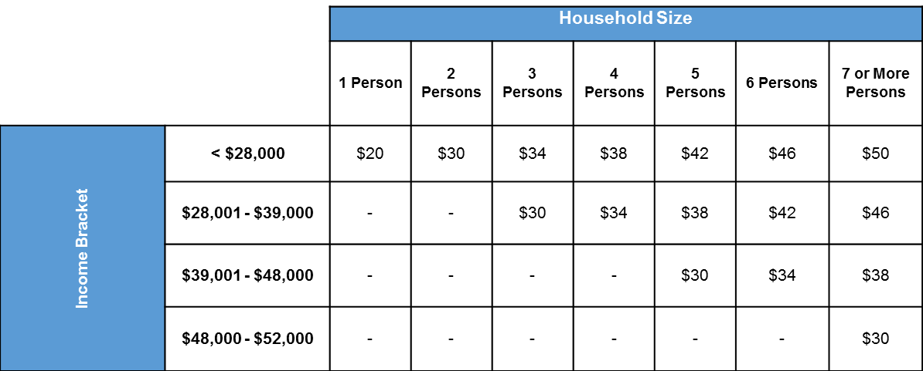
Sliding Scale Fixed Credit
The amount of the credit would depend on the customer’s income bracket and household size
Maximum credit of $50 per month or $600 annually
Average credit of $27

Slide 6
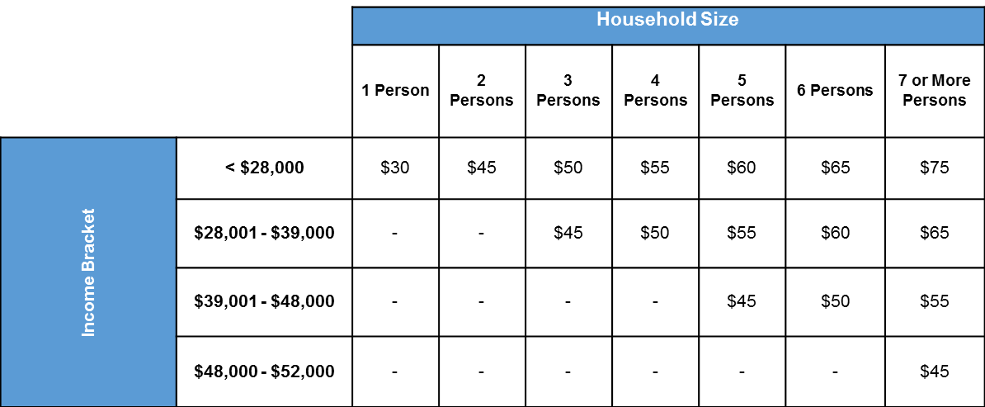
Energy Intensive Sliding Scale Fixed Credit
For customers with special electricity requirements, such as those with electric heat, medical devices requiring electricity and First Nations and Métis customers
Maximum credit of $75 per month or $900 annually
Average credit of $41

Slide 7
Estimated Bill Impact
The recommended approach is expected to benefit more than 500,000 low-income households
Costs to be recovered through a volumetric charge estimated to be between $0.0013/kWh - $0.0016/kWh
Estimated bill increase of <2% / month for average residential customer

Slide 8
Cost Recovery & Settlement
Costs will be recovered on a provincial basis from all rate-classes
All rate-classes contribute (consistent with LEAP)
Lessens rate impact by sharing costs among more customers
Funds are pooled and disbursed to distributors according to the cost of delivering OESP in their service area
Overcomes issues of disproportionate burden on distributors’ ratepayers due to widely varying densities of low-income customers among different distributors’ service areas
Legislation will be amended to give OEB authority to implement this type of charge
Similar approach to Rural and Remote Rate Protection charge (i.e. volumetric charge)
IESO will manage settlement
Variance accounts will be used to record amounts collected and amounts disbursed and ‘true-up’ costs recovered

Slide 9
Eligibility Criteria
The OESP will rely on Statistics Canada’s Low-Income Measure (“LIM”)
Consistent with Ontario’s Poverty Reduction Strategy
Customers of distributors, retailers and unit sub-meter providers will be eligible
Eligibility criteria to be consistent with all LEAP programs and, if possible, other provincial programs
Recipients of other low-income assistance programs (e.g. LEAP, Ontario Works, and Ontario Disability Support Program) will be eligible; however, these customers will still have to go through the application process in order to determine which credit they should receive based on their income bracket / household size
Applicants should be assessed one time for OESP & LEAP, including low-income CDM programs (i.e. “one window access”)
Eligible customers will only have to re-qualify every 2 years
Certain customers (e.g. seniors and those with permanent disabilities on fixed incomes, medical assistance program clients) may re-qualify less frequently (e.g. every 5 years)

Slide 10
Delivery / Intake
For greatest accessibility, applicants should have multiple ways to apply for OESP
Centralized Service (Online Application)
Primary intake source to facilitate greatest access in most efficient way
Facilitated by 3rd party (CRA verification of income)
Mirrors other provincial programs (i.e. ODSP)
Best approach to manage potential large influx of applications upon program launch
Supported by all stakeholders
LEAP Social Agency Partners
Supplementary intake source for non-tax filers and those requiring more holistic assistance
Provides a walk-in option as opposed to the online
Supported by all stakeholders
First Nation & Métis communities will perform their own intake through a separate but similar process

Slide 11
Evaluation Strategy
As a ratepayer funded bill assistance program the OESP is expected to be evaluated against the following measureable objectives:
Increased distributor efficiencies, including: reducing disconnections and reducing bad debt expense and collection activities
Improving payment patterns, i.e. fewer customers in arrears
Reaching intended beneficiaries, i.e. program uptake
Evaluation criteria similar to those relied on in other jurisdictions
Annual reporting of program results with a complete evaluation after 3 years of operating (similar to current LEAP review)
Reporting Requirements:
Many reporting requirements needed to evaluate against these objectives are already in place (i.e. RRR 2.1.8)
Some may be added e.g. to track funds

Slide 12
High Level Implementation Plan
2014 |  | 2015 |  |  |  |  |  |  |  |  |  |  |  |  |  | 2016
Dec |  | Jan | Feb | Mar | Apr | May | Jun | Jul | Aug | Sep |  | Oct |  | Nov | Dec | Jan
OEB Report to Minister
Government Decision on OESP
 |  |  |  | Legislation to implement OESP recovery mechanism (if needed)
 | Preliminary work – establish OESP expert Working Group, RFP for centralized service provider, develop program details & communications strategy
 |  |  |  | Develop system for centralized intake
 |  |  |  |  | LDC billing system/process changes
 |  |  |  |  |  |  | Program Communication & Consumer Outreach
 |  |  |  |  |  |  |  |  |  |  |  |  | Program intake begins
 |  |  |  |  |  |  |  |  |  |  |  |  |  |  |  | OESP credit on consumers’ bills

Slide 13
Implementation Cont’d.
Anticipated Work for LDCs & USMPs:
CIS / billing systems must support:
32 rate-credits to be applied to eligible customers (16 per sliding scale)
Sliding scales may change in future (e.g. income brackets as LIM is updated; or rate-credit amounts) systems should be designed to handle certain changes
Tracking / collecting data associated with new reporting requirements
Settlement mechanics between LDCs and USMPs
Bill changes to collect volumetric, provincial charge
Variance accounts to track program spending and support settlement with IESO
LDC / USMP websites must include link to application portal / main website for program information
Customer care & communications strategy to provide program information to customers

