Slide 1
Project Overview
August 2014

Slide 2
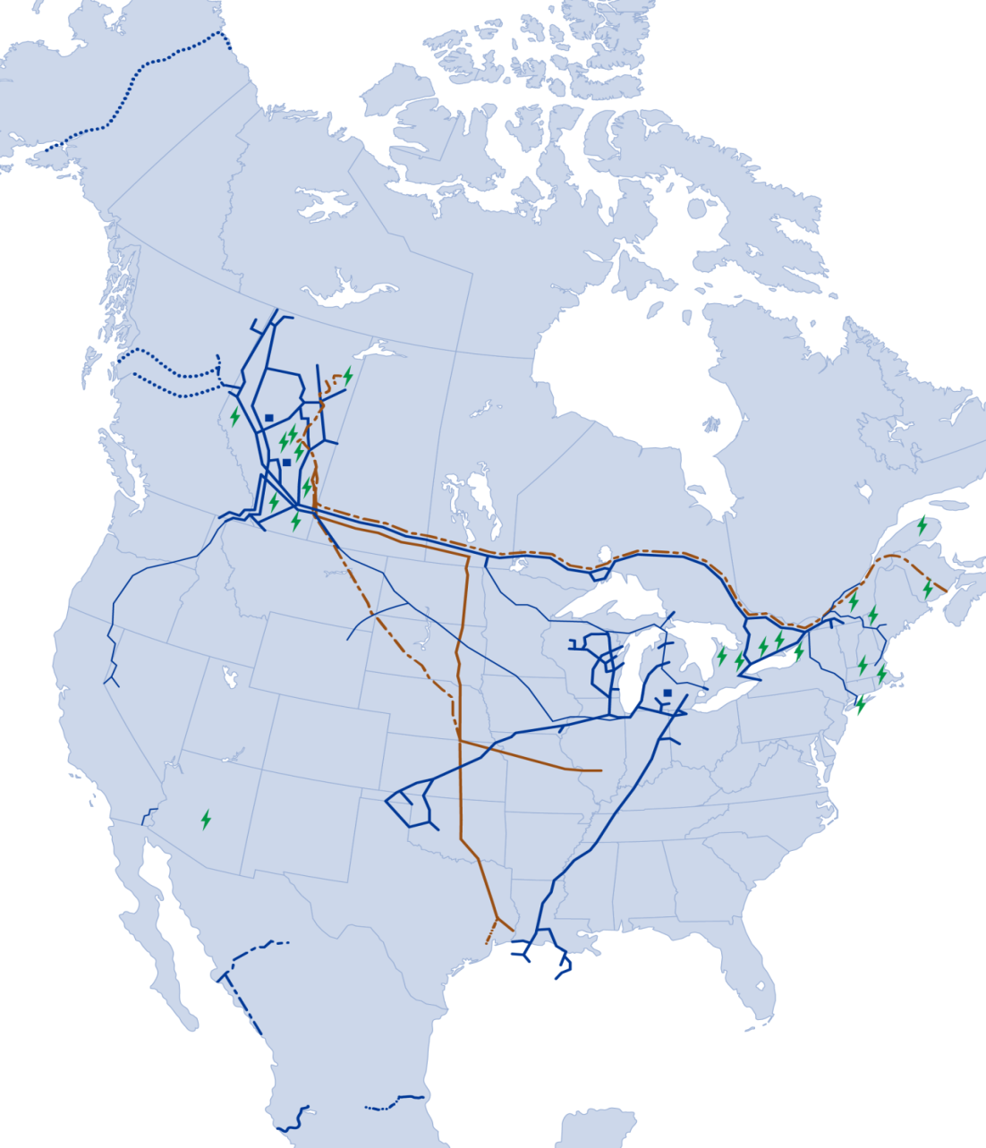
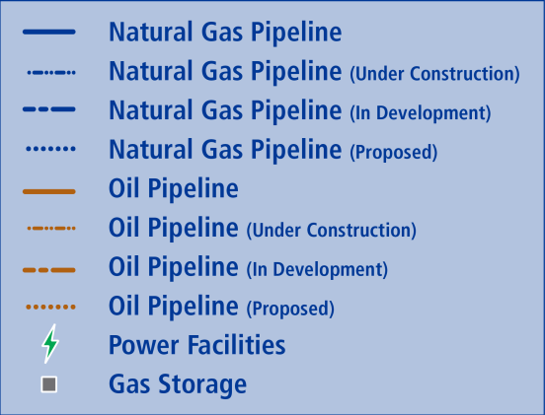
TransCanada: Leading North American
Energy Infrastructure Company
One of North America’s Largest Natural Gas Pipeline Networks
  68,500 km of pipeline
  14 Bcf/d or 20% of demand
Third Largest Natural Gas Storage Operator
  406 Bcf of capacity
Largest Private Sector Power Generator in Canada
  19 power plants, 10,800 MW
Premier Oil Pipeline System
  2.5 million bbl/d ultimate longhaul capacity

Slide 3
TransCanada’s Profile in Ontario
Length of Natural Gas Pipeline (km) | 8,106
Number of Power Plants | 1
Number of Land Owners | 5,364
Number of Employees | 285
Provincial Taxes | $15.7 M
Property Taxes | $75.2 M
Operations include Canadian Mainline natural gas pipeline and Halton Hills power plant. The Bruce Power and Portlands Energy Center, both partially owned by TransCanada, are not operated by TC and therefore have not been included in this summary

Slide 4
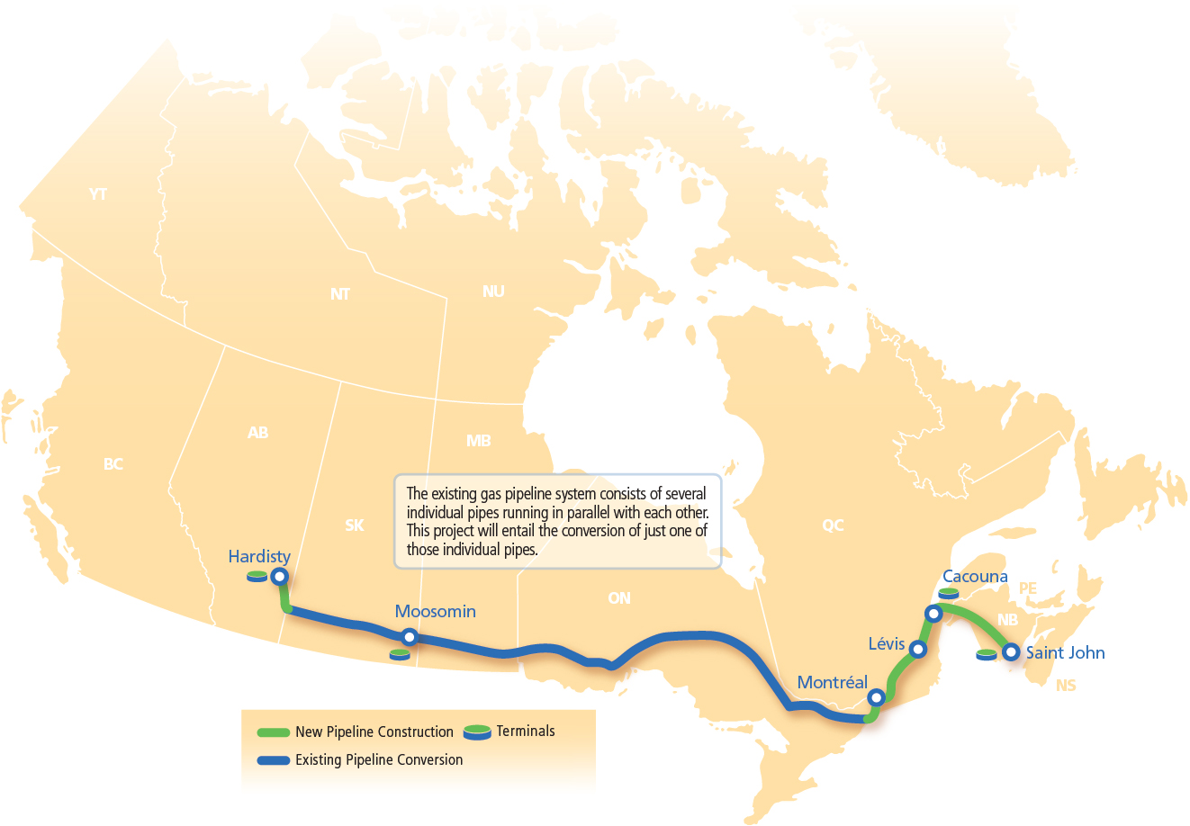
Energy East Pipeline
$12 billion investment, excluding transfer value of Mainline natural gas assets
1.1 million bbl/d of capacity with ~900,000 bbl/d of firm, long-term contracts
Anticipated to commence deliveries to Québec in 2018, with service to New Brunswick expected in late 2018
Notes:
Energy East
4,600 km pipe (1,600 km new build and 3,000 km converted line)
72 pump stations
4 tank terminals
2 marine terminals
Energy East in Ontario
104 km of new pipe
1,918 km of converted pipe
30 pump stations

Slide 5
Eastern Mainline Project
August 2014

Slide 6
Key Messages
All contracted gas transmission customers will continue to receive safe, reliable and cost effective gas transmission service – no market will go short of gas
Gas consumers are not subsidizing the Energy East project
Energy East and the required replacement capacity (the Eastern Mainline Project) will reduce gas transmission costs by more than $750 million over 15 years
Capacity needed to meet contracted requirements will be available prior to the transfer of existing gas transmission assets to Energy East
TransCanada will add future capacity should market need emerge

Slide 7
TransCanada Filing
Energy East will transfer 3000 km of pipeline from gas to oil transmission service
  Net Book Value = ~ $1 billion
TransCanada has just completed an open season to affirm the markets need for gas transmission service
New gas transmission requirements post transfer:
  575 TJ/d capacity
  250 km pipeline co-located with existing pipeline
  9 compressor units at existing stations
  $1.5 billion cost
TransCanada and Energy East shippers will contribute $500 million to Eastern Mainline Project cost

Slide 8
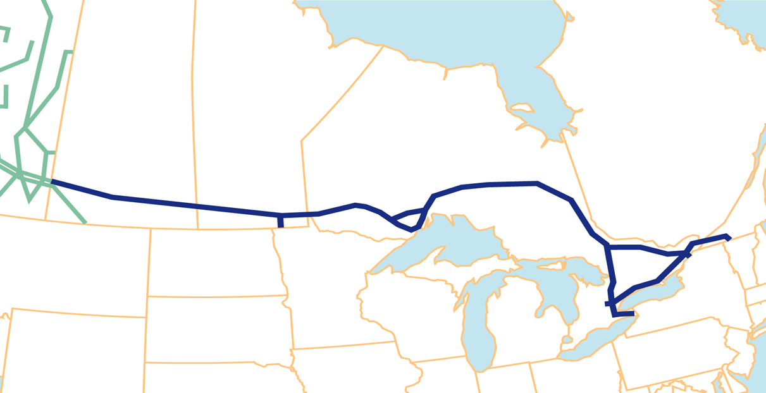
Mainline Asset Transfer and Replacement Facilities
Prairies
Line 4 - (5 lines remain in gas service)
930 km
Target Transfer Date: March 2016
Northern Ontario Line
All of Line 4, portions of Line 3
(Line 1&2 remain in gas service)
1650 km
Target Transfer Date:
March 2016
North Bay Shortcut
Line 2 - (Line 1 remains in gas service)
420 km
Target Transfer Date: March 2017
Eastern Mainline Project
Expansion of Montreal Line – 250 km
In service:
November/16 – March/17

Slide 9
Energy East and Eastern Mainline Project
Gas Shipper Issues:
  Transfer price
    Regulatory standard = NBV amongst regulated affiliates
    NBV of transferred assets = ~ $1 billion (20-25% of rate base)
    TransCanada filing position results in a $500mm premium to NBV - enhances value for gas shippers
  Gas transmission cost impacts
    Removal of 3000 km of existing pipeline
    Addition of 250 km of new pipeline and 9 compressors
      Reduces O&M, property tax, abandonment costs
    TransCanada and Energy East shipper contribution of $500 million
  Net result: gas transmission costs reduced by
  more than $750 million

Slide 10
Energy East and Eastern Mainline Project
Gas Shipper Issues:
  The North Bay Shortcut (NBSC)
  Gas shippers - leave in gas service
  NBSC is a pivotal piece of Energy East and is required for project – cost and schedule
  Enables transfer of 3000 km of pipe
  Eastern Mainline Project will allow market needs to be met and only requires 250 km of new pipe and associated compressors
  Delivers savings to gas shippers

Slide 11
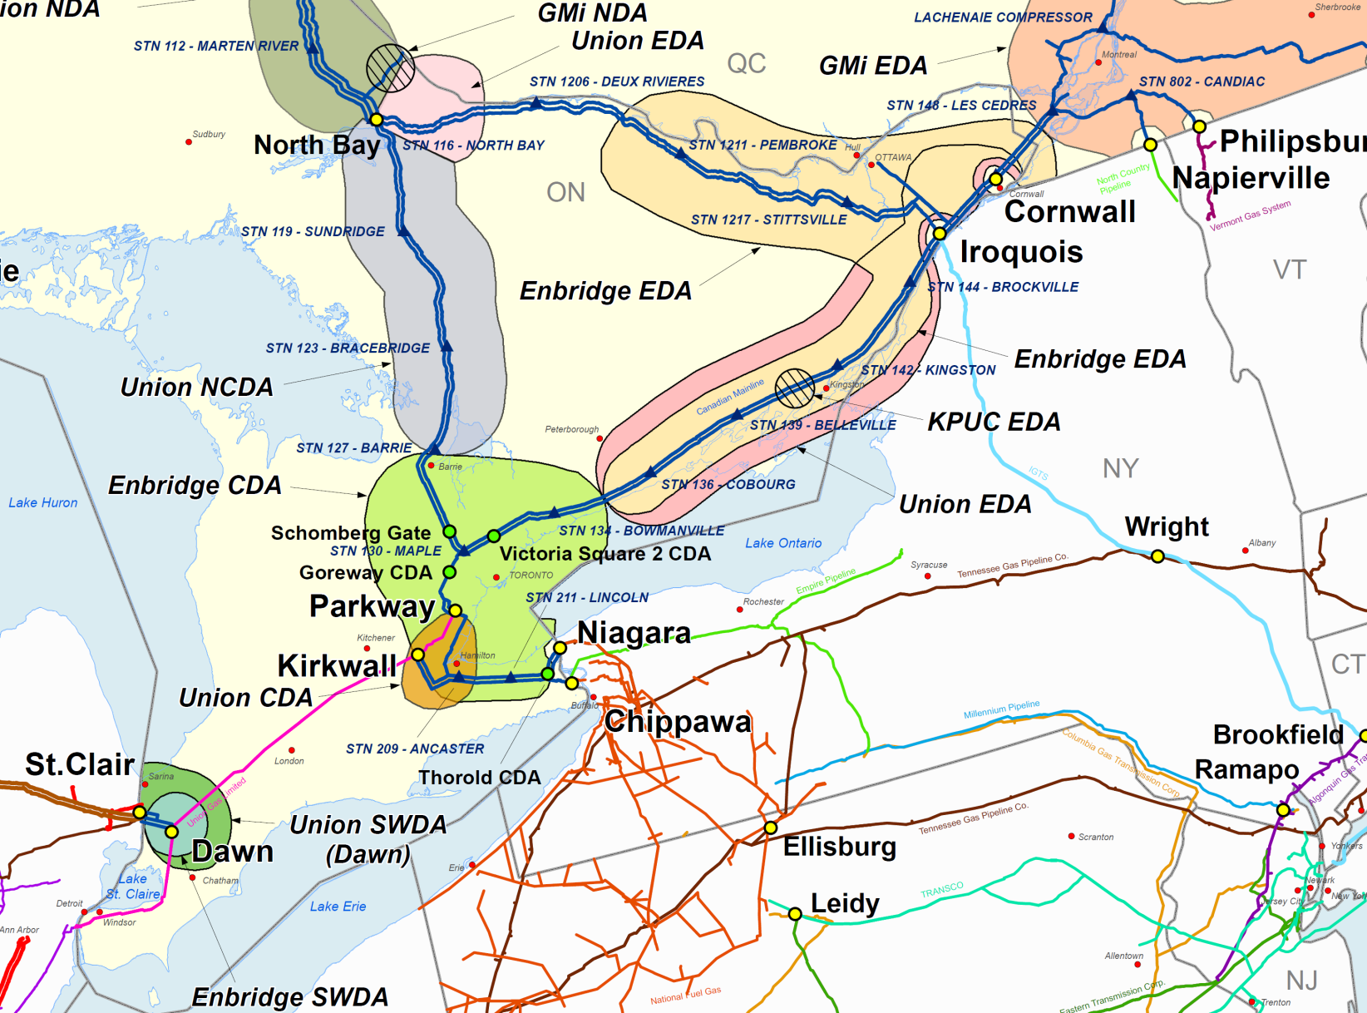
Southern Ontario Infrastructure

Slide 12
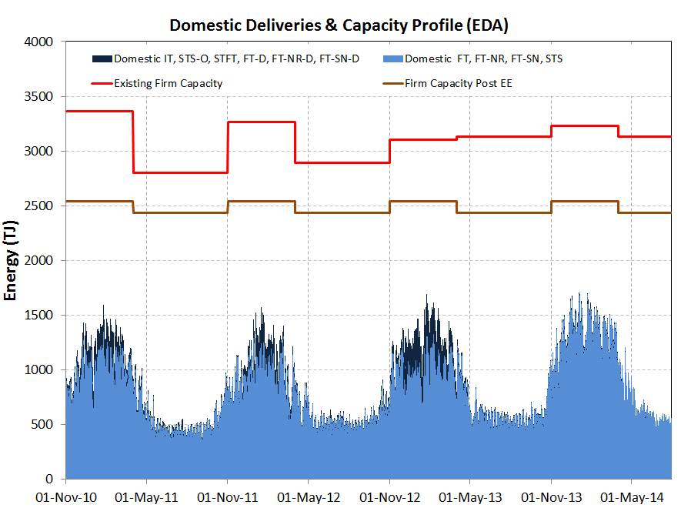
Eastern Delivery Area Capacity & Domestic Market Flow
Ample capacity to meet domestic markets

Slide 13
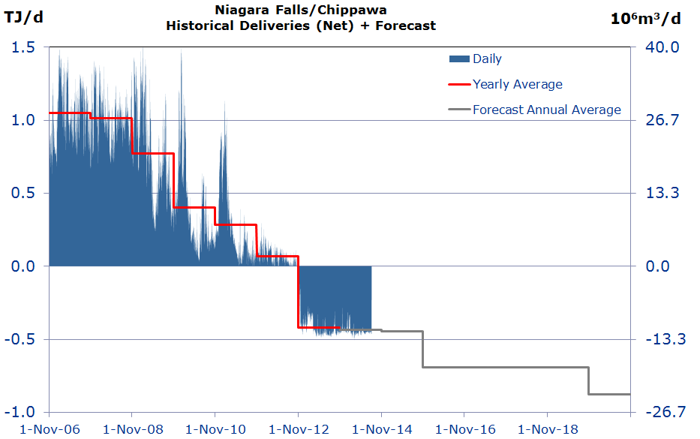
Central Delivery Area – Export Market Flow
Niagara/Chippawa flows transitioned to peaking exports, then imports

Slide 14
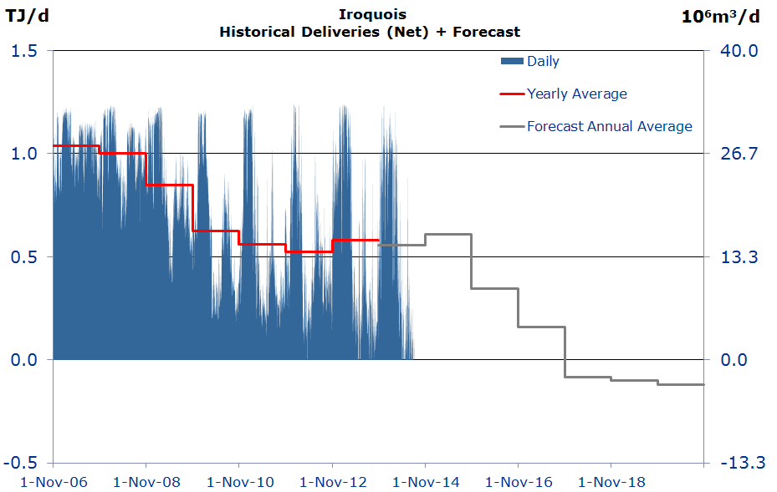
Eastern Delivery Area – Export Market Flow
Iroquois flows are exhibiting the same pattern; forecast to become imports

Slide 15
Eastern Canadian Export Flow
Bcf/d
History
Forecast

Slide 16
Energy East and Eastern Mainline Project
Gas Shipper Issues:
  Interruptible capacity
    Capacity that is used from time to time – no obligation to use or pay for capacity
    A number of markets have used this service to minimize their costs – but this leaves costs for others
    Shippers have pressed for disallowance of recovery of costs of un-contracted capacity
    NEB – markets that need service should pay annual cost of service
  TransCanada notified markets that interruptible service capacity will be reduced and provided opportunity to subscribe to firm service

Slide 17
Energy East and Eastern Mainline Project
Gas Shipper Issues:
  Interruptible capacity
    Unrecovered cost of interruptible capacity is largely borne by firm markets – end use consumers/residential
    NE US markets that direct connect to US supply will vacate Mainline capacity - cost recovery?
    TransCanada settlement offer
      Will construct interruptible capacity
      Reduces gas transmission cost savings
      Requires commitment that enables cost recovery

Slide 18
Key Messages
All contracted gas transmission customers will continue to receive safe, reliable and cost effective gas transmission service – no market will go short of gas
Gas consumers are not subsidizing the Energy East project
Energy East and the required replacement capacity (the Eastern Mainline Project) will reduce gas transmission costs by more than $750 million over 15 years
Capacity needed to meet contracted requirements will be available prior to the transfer of existing gas transmission assets to Energy East
TransCanada will add future capacity should market need emerge

Slide 19

Early and Extensive Engagement
Meetings with landowners, elected officials, municipalities, Aboriginal groups and other stakeholders
Information sessions and Open Houses for local stakeholders and residents
Engagement across Canada
  491 Municipalities
  155 Aboriginal Communities and Organizations
  More than 5,500 landowners
  More than 6,000 registered guests in 83 Open Houses

Slide 20


Our approach to communities
Acknowledge all stakeholders
Build relationships based on trust and mutual respect
Be a good corporate citizen of our host communities
Be present in and learn to understand the communities where we operate

Slide 21
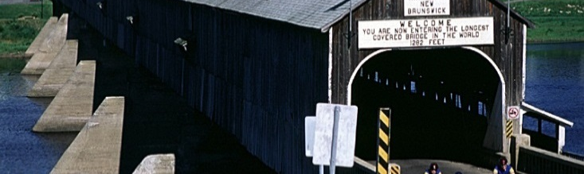
Stakeholder Engagement in Ontario
With more than 2,000 Km (1918 km of conversion and 100 km of new construction), Ontario is the largest host of Energy East
99 Communities
  88 Conversion
  9 Construction
29 Community Open Houses
  2,432 Attendees
Contacted 90 Chambers of Commerce/Economic Development Groups
Reached out to 150 other (E)NGOs

Slide 22
Stakeholder Activities in Ontario
30 Council/Mayor Presentations (in camera & public)
15 Other Municipal meetings (e.g. Ottawa Working Group, CAO Briefings, Councillor Briefings)
22 Other Stakeholder group meetings (e.g. conservation authorities, residents’ associations, ratepayers’ association)
14 EMR meetings
10 Tradeshows/Conferences
Received resolutions of support from 3 Ontario municipalities

Slide 23
ENERGY EAST PIPELINE
Key Issues/Concerns
Water
Pipeline Safety & Integrity of the system
Emergency Preparedness and Response
Economic Impact
Drinking Water
Wildlife Protection
Water crossings
Age of Pipe
Risks of Leaking/ Rupture
Monitoring Integrity
Routing
Nature of the product
Preventative & corrective actions in the community
How is the community involved
When will the community be engaged
Local Economic Impact
Taxes
Jobs
Camps
Gas and Power supply & prices

Slide 24



Safety & Environment Protection
TransCanada is committed to environmental protection and safe and reliable operations
Notes:
Environmental Protection
The project will adhere to the strictest environmental guidelines
Our Environmental Protection Plan will mitigate potential impacts during and after construction
Committed to preserving important natural and cultural features
Collaboration with local communities and Aboriginal groups for data collection
Safety
Pipelines are the safest way to transport oil
Use of advanced pipeline technology
Additional safety features at road, rail and water crossings
Heavy-wall pipe, deeper pipe burial, installation of additional isolation valves
Pipeline will be monitored through a high-tech control centre 24 hours a day, 365 days a year

Slide 25
Engagement – EMR
Outreach:
  March 2014:
    sent introductory package to 268 first responders at 244 agencies (including police, fire, paramedics, municipal emergency coordinators, 911 dispatch centres)
  April & June 2014:
    coordinated 10 introductory Emergency Management consultations
    met with 177 individuals representing 129 agencies (including first responders, municipal/provincial agencies, NGOs, and First Nations)
    attended EMR exercise in the United Counties of Leeds and Grenville
  Next Steps:
    developing EMR-specific plans for communities
    sending follow-up “update” letters once project is filed with the NEB
    attending/participating in table top exercises

Slide 26
Engagement – EMR
  Basic Feedback:
    Integrated approach to EMR planning/training, and integrating provincial incident reporting/command systems, developing inter-provincial mutual aid agreements, discussing environmental hazards & water crossings
  Community-Specific Feedback & Concerns
Northern Ontario
familiarizing stakeholders with control centre operations & incident response
concerns regarding communications systems/ability to report and respond to incidents in Northern Ontario
Ottawa & Valley
developing mitigation risks in relation to seismic activity
report to Council by the Fire Chief of the Municipality of North Grenville commending TransCanada for early engagement
New Build
suggested follow-up meeting with County-wide EMR group
outreach to local contractors for emergency response services
Developing mitigation risks in relation to forest fires
proposed follow-up meeting to discuss pipeline integrity

Slide 27
Ontario Engagement: Next Steps
Continuation of 2nd round of Ontario Open Houses
  8 in August 2014, 3 (potentially) in November
Active involvement in Trade Shows and Conferences to increase Exposure
  AMO (August) & CEPO (September)
New round of briefings with any newly elected Mayors or councillors after elections
27

Slide 28
First Nation and Métis Engagement Framework
 | ENGAGEMENT
General Approach | Information Sharing | Comprehensive Engagement/TLU-TKE
Key Activities | Initial meeting setup/planning Chief, council and possible tribal council meetings and presentations Information and brochure provision Presentation of letter of agreement Community acceptance of LOA and further preparations | Chief/council, committees, elders meetings CEFA preparation and acceptance Financial payment TLU/TEK work undertaken Project agreement developed Mitigation activities developed
Expected Outcomes
Information Sharing
Letter of Agreement
(LOA)
CommunicationEngagement Funding Agreement (CEFA)
Project Agreement or Mitigation activities
(PA)

Slide 29
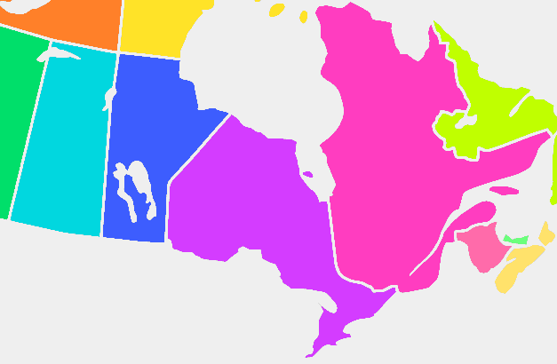
National Snapshot of First Nation and Métis Engagement
Alberta
Total – 12
Manitoba
Total – 19
Saskatchewan
Total – 23
Ontario
Total – 63
Quebéc
Total - 22
New Brunswick
Total - 16
Nova Scotia - TBD
Total Communities/Organizations: 155

Slide 30
Benefits to First Nations/Métis
Energy East has the potential to benefit First Nation & Métis communities in many ways:
  Jobs - enhanced consideration for jobs (construction and operation); targeting of under-represented people in project-related recruitment
  Procurement - actively encourage Aboriginal business through supplier diversity policies
  Capacity Support - immediate benefits throughout engagement process and negotiated capacity supports
  Impact Mitigation - communities with significant impacts may benefit from measures to accommodate or mitigate impacts

Slide 31
Top Issues or Concerns
Economic Opportunities and Benefits
Expectations for revenue sharing, equity, partnerships, contracting and procurement
Benefits
Project Timelines and Adequacy of Engagement
Information has been limited to date and has impacted timing of agreements, engagement,
and TK studies
Technical Literacy
Communities focused on catastrophic failure, pipeline integrity, emergency response
Engagement Process
Historical grievances and role of the Crown
Access to Senior Management
Communities constantly requesting VP representation

Slide 32
EEP Land Department Role
  Engage with landowners for survey access, consultation and negotiation for land rights
  Effectively coordinate the acquisition of all land rights
  Provide governance, strategy, processes and procedures over land acquisition
  Manage construction commitments and reclamation issues with landowners

Slide 33
Pipeline Land Requirements for Ontario
104 km New Build pipeline
    93.1 km’s parallels existing pipeline(s)
    402 total parcels
    307 landowners
1918 km of Conversion pipeline
    2409 total parcels
    1917 landowners
2224 landowners
88% private, 12% crown
30 pump stations (15 crown, 15 privately owned)
Property valuation of ROW done through area benchmarking
Where new land required, landowners will be offered compensation based on NEB guidelines and fair market principles

Slide 34
Our Engagement Thus Far
New build pipeline and Pump Stations
  Individual consultation and survey access meetings with every landowner
  Multiple mail-outs to all (open house schedules, information letters, newsletters)
  Commenced negotiations on facilities
Conversion
  Completed/attempted phone consultation with all landowners
  Completed personal consultation where requested
  Multiple mail-outs to all (open house schedules, information letters, newsletters)
  Commenced negotiations on facilities

Slide 35
What’s next with Landowners
Pipeline
  Recently commenced acquisition program on pipeline (August 2014)
    includes new easements, valve sites, river crossings (all new land rights required for project)
Pump Stations
  Commenced negotiations on private lands Spring 2014
  MNR discussions ongoing

Slide 36

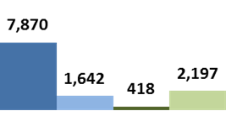

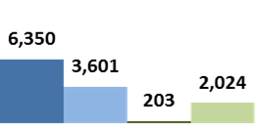

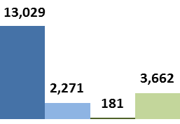



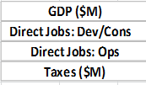
Deloitte Economic Analysis
ONTARIO
GDP: $13B GDP
Direct Jobs
  Over 500 direct jobs / yr (development, 3 yrs)
  Over 1,700 direct jobs / yr (construction, 3 yrs)
  Over 180 jobs / yr (operations, 40 yrs)
Tax Revenues
  $798M (development & construction)
  $2.9B (operations)
Canada
$35B GDP
10,000 direct jobs (development & construction)
1,000 direct jobs (operations)
$10B Tax Revenues
Notes:
Slide contains results from the Deloitte Study.
The following are preliminary construction workforce estimates from our internal Project team.
Preliminary number of spreads
14 spreads along conversion portion
2 spreads along new build portion

Slide 37

Energy East – Vendor Portal
  How to access Vendor Portal for Registration:
  Energy East Pipeline Website (www.energyeastpipeline.com)
  In “About” tab, scroll down and click “Contractors and Vendors”

Slide 38
Project Benefits
  Domestic source of crude oil for eastern refineries
      Displace higher cost foreign imports
      Expansion and upgrade opportunities
  Increased crude oil capacity from western Canada
      Access to new Eastern Canadian and export markets
      Reduced price discount
  Re-purposing gas pipeline to oil service
      Minimize constructing new pipeline
      Significantly reduced environmental impact

