Slide 1
Regulatory Accounting Webinar
Ontario Energy Board
Regulatory Accounting Team

Slide 2
Disclaimer
This slide deck is derived from the presentation delivered during the Regulatory Accounting Webinar. It is intended to provide educational information to the sector regarding regulatory accounting and IESO settlement adjustments. It is not intended to advise on utilities' specific proposals in their rate applications. Furthermore, the slide deck represents the views of Ontario Energy Board (OEB) staff based on OEB staff observations in past rate applications and the legal and regulatory requirements currently in place – if the facts or the requirements were to change, OEB staff’s views might be different. The slide deck is not offered as and does not constitute legal advice, and is not binding on the OEB.

Slide 3
Agenda
01
Welcome/Land Acknowledgement
Tina Li
02
MRP Accounting Guidance Updates
Helena Wang
03
The IESO Two-year Regulation and
its Impact on the Commodity Accounts
Tina Li
04
Commodity Accounts Analysis
Workform Updates
Helena Wang
05
Staff Observation of Common Mistakes
Pauline Shen
06
Q&A

Slide 4
Land Acknowledgement
The Ontario Energy Board acknowledges that our headquarters in Toronto is located on the traditional territory of many nations including the Mississaugas of the Credit, the Anishnabeg, the Chippewa, the Haudenosaunee and the Wendat peoples. This area is now home to many diverse First Nations, Inuit and Métis. We also acknowledge that Toronto is covered by Treaty 13 with the Mississaugas of the Credit.
As we gather, we acknowledge that we are coming together from diverse regions, each with its own Indigenous peoples, ancestral lands, and treaties. I (we) recognize and honour the Indigenous communities, their elders, past and present, as the traditional custodians of these lands.
We are grateful for the opportunity to gather and work on these lands and recognize our shared responsibility to support and be good stewards of them.

Slide 5
Market Renewal Program (MRP) Accounting Guidance Updates

Slide 6
MRP Accounting Guidance Updates
June 12, 2024
April 28, 2025
May 14, 2025
The OEB issued a draft update to the Accounting Guidance for the Commodity Pass-through Variance Accounts 1588 and 1589, resulting from the IESO’s MRP
The OEB issued finalized Accounting Guidance updates for the Commodity Pass-through Accounts 1588 and 1589
The OEB issued a corrected version of Appendix A to address a mapping error
Draft Accounting Guidance Updates for MRP
Finalized Accounting Guidance Updates for MRP
Revised Appendix A

Slide 7
How Do Different Market Conditions Impact the Accounting Guidance Updates?
MRP Market Condition |  | Impact on the Accounting Guidance
Normal Market Condition IESO calculates the electricity price using Day-Ahead Market (DAM) Ontario Zonal Price (OZP) adjusted by the Load Forecast Deviation Adjustment (LFDA) |  | The market condition has No Impact on the Accounting Guidance and illustrative examples for the Commodity Accounts because the Accounting Guidance relies on the IESO invoice for the energy used by the distributors, in which the OZP and LFDA are combined into one line item. The final Accounting Guidance update related to the MRP applies under all market conditions
Abnormal Market Condition IESO calculates a Real-Time Market OZP without applying any LFDA

Slide 8
MRP Accounting Guidance Updates – Key Updates
Accounting Guidance
No New Variance Account
New/Revised Charge Type (CT)
Updated guidance on the accounting for Commodity Accounts 1588 and 1589, including Regulated Price Plan (RPP) settlements and true-up processes
No sub-accounts under Account 1588 to separately track the variance due to LFDA
Two Reconciliation tables provided for record-keeping purposes
CT101 (HOEP) is replaced by CT1115 (DAM OZP + LFDA)
Comprehensive mapping of IESO CTs to OEB Uniform System of Accounts (USoAs)

Slide 9
Accounting Guidance Update: RPP Settlement Process
IESO RPP Settlement and True-Ups Processes
IESO Settlement Process |  | Updates
Initial RPP Settlement Claim |  | Incorporated the addition of the DAM OZP and estimated LFDA values under the MRP
RPP Settlement 1st True-Up |  | DAM OZP plus LFDA values used in the initial RPP settlement claim are to be trued up to the final energy price charged by the IESO comprising of DAM OZP plus LFDA under CT 1115.
No updates on the RPP settlement 2nd true-up process.

Slide 10
Accounting Guidance Update: Illustrative Commodity Model
Summary of the Main Changes
Model trues-up the estimated DAM OZP plus LFDA to the final billed amount from IESO in CT 1115
Tables 9a, 18a and 30a added to lay out calculations of unit cost per kWh split between RPP and non-RPP customers
Two new reconciliation tables are added in the new tab “Variances in ac 1588” for record keeping purposes to quantify: Table 42 - The variance between preliminary DAM OZP & LFDA and amounts billed by IESO under CT 1115 Table 43 – The variance between payments made to embedded generators at preliminary pricing and amounts billed at IESO pricing

Slide 11
Accounting Guidance Update: Appendix A
Mapping of IESO Charge Types to OEB Uniform System of Accounts
The IESO charge types outlined in Appendix A are the identified charge types (including new and updated charge types) under the IESO's Market Renewal Program as of April 28, 2025.
On May 14, 2025, the OEB issued a corrected version of Appendix A to address a mapping error related to IESO Charge Types 651 and 652. These two Charge Types are now mapped to Account 4716, Charges – CN, correcting the previous mapping to Account 4068, Billed – CN.

Slide 12
IESO Two-Year Regulation and Its Impacts on the Commodity Variance Accounts

Slide 13
Type of IESO Settlements Impacting the Commodity Variance Accounts
RPP Variance Settlement
This monthly settlement impacts Account 1588 RSVA Power because the settlement and its true-ups need to be journalized in Account 1588, as per the Accounting Guidance for the Commodity Accounts.
Embedded Generation (EG) Settlement
This monthly settlement impacts both commodity variance accounts 1588 and 1589 in two ways: 1) Cost of power from EG and contract price variance settled with the IESO are journalized in Account 1588; 2) the IESO uses the EG volumes to allocate the Class B GA cost to the distributors.
Class A Consumption Reporting
The monthly consumption reporting indirectly impacts commodity variance accounts 1588 and 1589 because the IESO uses the Class A consumption reported by the distributors to allocate the Class B GA cost.
Class A Customer Annual Declaration
The annual reporting impacts the Class A billings to Class A customers. It does not impact commodity accounts 1588 and 1589 except when the customer was transitioned from Class B to Class A or vice versa during the year.

Slide 14
Class B Global Adjustment $ Allocated to the Distributors
RPP portion of the GA variance flows to the RPP variance account held by the IESO and flows into the next RPP price setting process
RPP portion of the Class B GA $ is reflected in Account 1588
IESO determines the Total GA $ allocated to the distributor: The actual GA rate for the month X the distributor's Class B loads (AQEW + EG reported by the distributor – Class A consumption reported by the distributor)
IESO Invoice
Distributors (Regulatory accounting)
Non-RPP portion of the GA variance flows to the distributor's Non-RPP customers when Account 1589 is disposed
Non-RPP portion of the Class B GA $ is reflected in Account 1589

Slide 15
Incorrect IESO Settlements and The Implications on the Commodity Pass-through Variance Accounts
Incorrect RPP Variance Settlements
Incorrect Embedded Generation
Incorrect Class A Consumption & Declaration
Result in inaccurate balance in Account 1588 and Account 1589
Result in inaccurate balances in Account 1588 and Account 1589
Result in inaccurate balances in Account 1588 and Account 1589

Slide 16
Ontario Regulation 153/23 – Two Year Limitation Regulation
No market participant, consumer, entity or person shall be entitled to seek or receive any payment, adjustment or amount, or be required to make any payment or adjustment or to pay an amount, from or to the IESO if:
the invoice for the payment, adjustment or amount was issued by the IESO more than 24 months ago; and
the payment, adjustment or amount is based on an entitlement or a specified charge that arises under or was invoiced under any of the provisions in Section 2 (b)
In July 2023, the Government of Ontario implemented a two-year limitation regulation for submitting adjustment claims related to specific settlement amounts.
Section 36.1.1(7) allows the IESO authority to make or receive a payment or pay or receive an amount despite the 24-month limitation where the payment or adjustment results from (for example):
(b) a decision, an order or a direction of the OEB in respect of a variance account; or (c) any form of compliance or enforcement activity, determination or direction of the OEB or an assurance of voluntary compliance given to the Board under section 112.7 of the OEB Act.

Slide 17
Process to Adjust the IESO settlements and book the adjustments in the Commodity Variance Accounts after the Two-year limitation Regulation
Distributor who identified the adjustments to the IESO settlements
Book the adjustments in DVAs to eliminate the impact of these IESO adjustments.
Reflect these adjustments in the Commodity Accounts Analysis Workform.
Disclose the adjustments in the rate application
Confirm with the IESO whether the settlement adjustments are subject to the two-year limitation regulation
Submit the adjustments to the IESO
Customers
IESO

Slide 18
Potential Rates Retroactivity Issue related to the IESO Adjustments
The impacted Commodity Variance Account’s balance in that year was disposed on a final basis
Address the potential rate retroactivity issue, as per the OEB’s letter issued on Oct 31, 2019
Adjusting entries are needed in the relevant Commodity Variance Accounts to eliminate the impacts of these IESO Settlement Errors in the year(s) of the errors
The distributor identified adjustments to the past IESO Settlements
The impacted Commodity Variance Account’s balance in that year was not disposed on a final basis
No rate retroactivity issue for the accounting adjustment(s) of the IESO settlement errors
Note: It is up to the panel in each rate application to decide whether to approve/disallow these adjustments.

Slide 19
Commodity Accounts Analysis Workform Updates

Slide 20
Commodity Accounts Analysis Workform - Updates
Workform & Instructions
Name Change
Workform
Note 7a
Instructions
Appendix B
Instructions –
Two-year limitation period example
Workform name changed from “GA Analysis” to “Commodity Accounts Analysis” to reflect additional testing for Account 1588 – RSVA - Power
Excel Workform now includes Note 7a, to be completed if a distributor’s balance in Account 1588 exceeds +/- 1% as a % of its cost of power purchased, in a year
Added Appendix B with illustrative examples and guidance for common principal adjustments and reconciling items that impact Account 1588
Added illustrative example to show how distributors might reflect principal adjustments and/or reconciling items, within the two-year period and outside of the two-year limitation period

Slide 21
Commodity Accounts Analysis Workform – Note 7a
Distributors to provide a more comprehensive explanation of the variance in Note 7a by quantifying the reconciling items/principal adjustments.
 | Item | Amount | Explanation |  |  |  |  | Principal Adjustment on DVA Continuity Schedule | If "no", please provide an explanation³
1a | CT 148 True-up of GA Charges based on Actual RPP Volumes - prior year
1b | CT 148 True-up of GA Charges based on Actual RPP Volumes - current year
2a | CT 1142/142 true-up adjustment based on actual price and volume - prior year
2b | CT 1142/142 true-up adjustment based on actual price and volume - current year
3a | Remove prior year end unbilled to actual revenue differences
3b | Add current year end unbilled to actual revenue differences
4a | Significant prior period billing adjustments recorded in current year
4b | Significant current period billing adjustments recorded in other year(s)
5 | Unaccounted for Energy Variance (eg. Variance due to significant understated/overstated line loss factor)
6
7
8
 | Total Reconciling Items | $ -

Slide 22
Illustrative Example – Charge Type 142
In January 2025, the distributor submitted an RPP consumption adjustment in December 2024. This adjustment (CT142) was reflected in the IESO February 2025 invoice (current year).
Data | RPP Rate | RPP Energy Price | GA Price | kWh Volumes | RPP Settlement
Estimated | $0.0880 | $0.0310 | $0.0780 | 6,000,000 | ($126,000)
Actual | $0.0880 | $0.0320 | $0.0790 | 5,010,000 | ($115,230)
True-up |  |  |  |  | $10,770
Scenario A: if the CT142 true-ups recorded in 2024 GL, then:
Reconciling item/ principal adjustment:
None because $10,770 was recorded in the 2024 GL
Scenario B: if the CT142 true-ups recorded in 2025 GL, then:
Reconciling item/ principal adjustment:
$10,770 in the 2024 Workform and the 2024 DVA Continuity Schedule
Reversal in the 2025 Workform and the 2025 DVA Continuity Schedule

Slide 23
IESO Settlement Adjustments – Decision Tree
Commodity Accounts Disposed on a Final Basis?
Same steps as below, AND
Potential Rate Retroactivity Issue: the distributor should disclose the adjustments and address the potential rate retroactivity issue.
Yes
Yes
Settlement adjustment within two-year period?
No
Submit the settlement adjustment to the IESO.
Record the adjustments per OEB Accounting Guidance
Commodity Accounts Disposed on a Final Basis?
Same steps as below, AND
Potential Rate Retroactivity Issue: the distributor should disclose the adjustments and address the potential rate retroactivity issue.
Yes
No
No
May seek OEB order to grant exception, if applicable.
Add principal adjustment(s) to DVA Continuity Schedule.
Add reconciling item(s) to Commodity Accounts Workform, i.e. eliminate impact from reasonability test

Slide 24
Illustrative Example - IESO Settlement Adjustments
In January 2025, Utility ABC identified a submission error for May 2021, where Class A consumption was understated in the IESO submission. As a result, the Class B GA charge (CT 148) on May 2021 IESO invoice was overstated, since GA costs were incorrectly allocated to Utility ABC.
Description | Value
Overstated Class B GA (CT 148) (shown on May 2021 IESO Invoice) | $346,261
RPP share – 60% | $207,757
Non-RPP Class B share – 40% | $138,505
The adjustments required are:
Reconciling Item:
Account 1588 - ($207,757) in the 2021 Workform
Account 1589 - ($138,505) in the 2021 Workform
Principal Adjustment:
Account 1588 - ($207,757) in the 2021 DVA Continuity Schedule
Account 1589 - ($138,505) in the 2021 DVA Continuity Schedule

Slide 25
Staff Observation of Common Mistakes

Slide 26
Summary of Common Mistakes
Rate Application
DVA Continuity
GA (Commodity Accounts) Analysis Workform
Line Loss Difference & Impact on Account 1588
Rate Retroactivity Issue
Account 1592 Sub-account CCA Changes & Smoothing Mechanism
Recording Non-utility revenue/expense
Mismatching balances
Issues noted in Account 1595
GA Tab
Account 1588 Reasonability
Principal Adjustments

Slide 27
Significant Line Loss Difference contributing to Large Balance in Account 1588
Observation 1: Some distributors explained that a large balance (greater than 1% of Cost of Power reported) in Account 1588 has resulted from significant differences between its approved and actual line loss factors.
OEB Policy
The distributors propose the loss factors in their cost-based applications. As per Section 2.8.8 Loss Adjustment Factors of Chapter 2 Filing Requirements, the distributors must document the proposed Supply Facilities Loss Factor, distribution and total loss factors for the test year.
Requirements
The distributor should correctly forecast the reasonable line loss factors in the cost-based applications. If there is a significant difference between the approved and actual line loss factors, the distributor needs to quantify the impact of the difference and include the quantification in the Account 1588 table of the Commodity Variance Account Workform.
In several IRM applications, OEB Staff notes that the panels had ordered the distributors with such issue to investigate the reasons behind the significantly higher line losses.

Slide 28
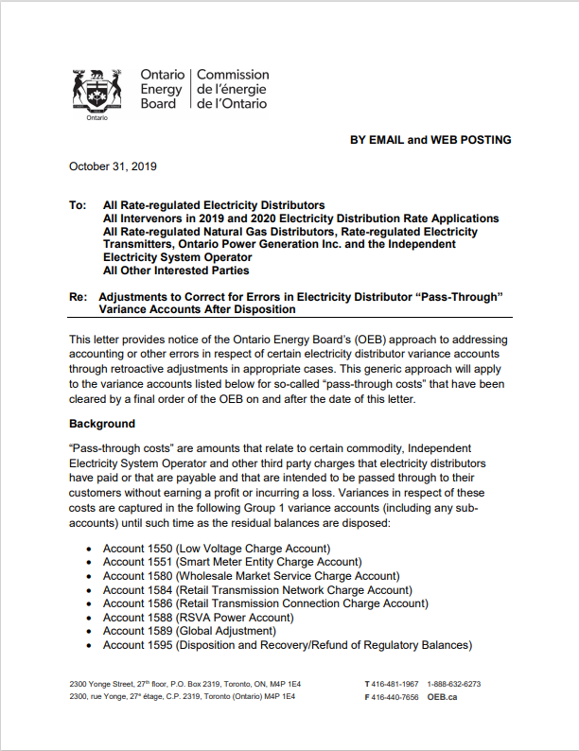
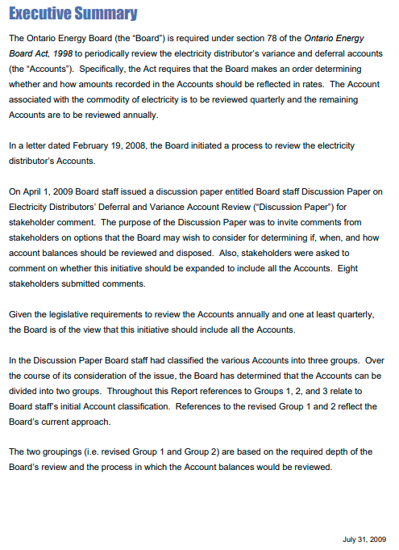
Rate Retroactivity Issue Identified from the Rate Application Process
Observation 2: Rate retroactivity may arise from the rate application process based on the questions asked by OEB staff. For example, the distributors may include the prior-period adjustment into the opening balance of a DVA that has already been disposed of on a final basis in the last rate proceeding.
OEB Policy
On October 31, 2019, the OEB issued a letter providing an approach to address accounting or other errors regarding the retroactive adjustments in pass-through DVAs. The letter states that “the OEB expects electricity distributors to disclose errors that have been discovered in their accounting records and to record correcting adjustments to the affected accounts in the year in which the error is discovered.” The distributors are also expected to disclose such adjustments in the rate applications.
Requirement
Whenever the rate-retroactivity issues arise during the rate application, the distributor should provide the supplemental evidence to address the requirements stated in the October 31, 2019 OEB letter.
(Note: It is up to the OEB to determine whether it will allow the retroactive adjustments.)

Slide 29
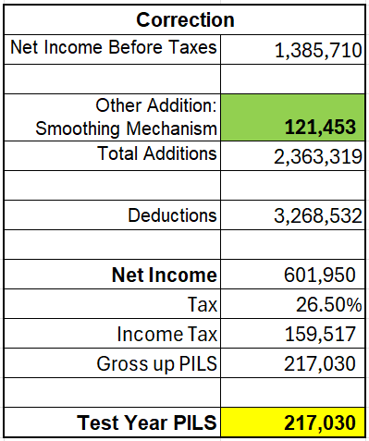
Account 1592 Sub-account CCA Changes & Smoothing Mechanism
Observation 3: Some distributors either did not provide the smoothing calculation as part of the pre-filed evidence in the cost-based applications or did not calculate the smoothing mechanism correctly.
OEB Policy
The Accelerated Incentive Investment Program (AIIP) is still in effect until 2027. As a result, the CCA change sub-account under Account 1592 needs to be used for the cost-based applications for the rate years until 2027.
Chapter 2 of Filing Requirements states that:
Rebasing period for 2025~2029 and applying AIIP
“Distributors may propose a mechanism to smooth the tax impacts over the five-year IRM term. The OEB will assess a distributor’s smoothing proposal on a case-by-case basis. If the OEB approves the smoothing proposal, the distributor’s use of (or access to) Account 1592 will no longer be applicable.”
Requirements
The distributor should provide the calculation of the smoothing mechanism as part of the pre-filed evidence. In addition, the calculation should be done correctly.
Smooth the tax impacts over the five-year IRM term.
If PILs is not smoothed over the IRM term, Account 1592 would generally be expected to be used since the AIIP will be phased out starting in 2024.

Slide 30
Non-utility Revenue/Expense
Observation 4: Some distributors include non-utility revenue/expense in the revenue requirement, resulting in overstated revenue requirement and understated other operating revenue.
OEB Policy:
Chapter 2 of Filing Requirements states that:
“If distributors engage in activities that fall within the parameters set out in sections 71(2), (3) or (4) of the Act, those non-distribution activities must be accounted for separately from distribution activities to assist the OEB in ensuring that costs related to these non-distribution activities are not included in rates”.
Requirements:
Per Accounting Procedures Handbook (APH) issued in January 2012
Non-utility revenue should be recorded in Account 4375 Revenues from Non Rate-Regulated Utility Operations
Non-utility expenses should be recorded in Account 4380 Expenses of Non Rate-Regulated Utility Operations
Non-utility revenue/expense should be included in other operating revenue and be excluded from base revenue requirement

Slide 31
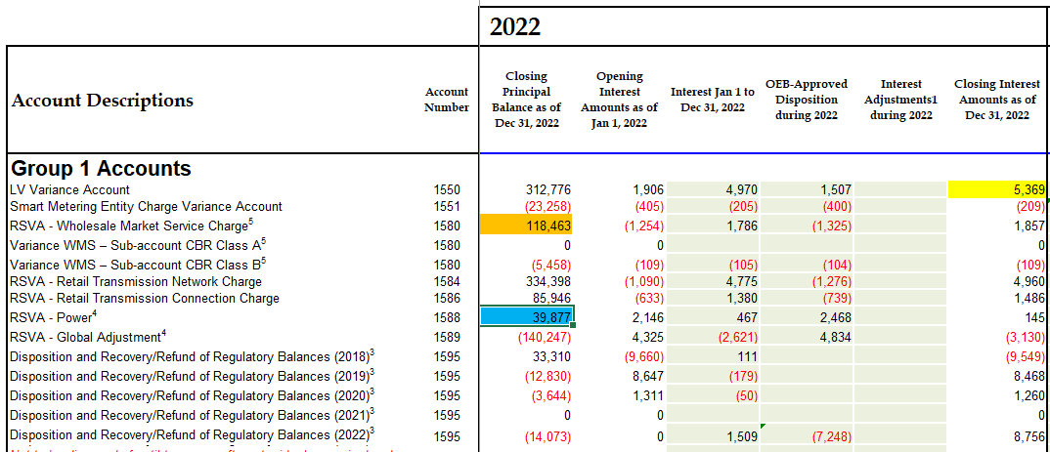
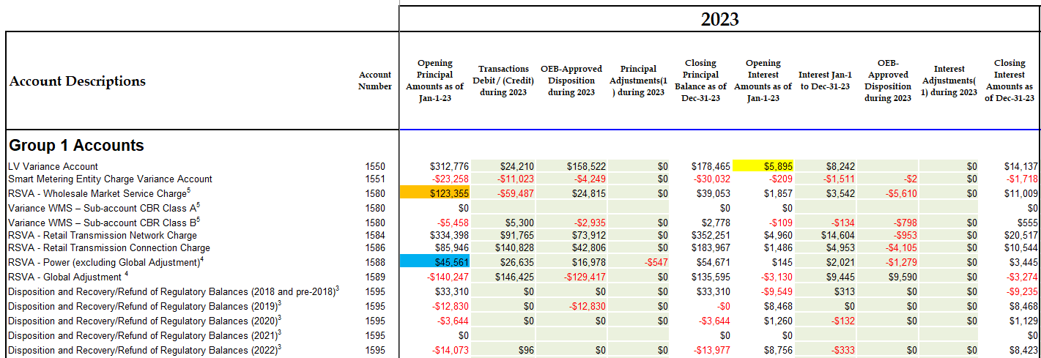
DVA Continuity Schedule
Observation 1: Mismatching Balances - The opening balances of certain DVAs do not match the ending balances of those DVAs in the last application, resulting in risk of retroactive adjustments in the last applications.
Requirement
Per Chapter 2 Filing Requirements (section 2.9), the opening principal amounts and the opening interest amounts for Group 1 and Group 2 balances, shown in the DVA Continuity Schedule of the current application, must reconcile with the last applicable approved closing balances. The distributor should disclose the adjustments if it is necessary to change the opening balances
2024 IRM Application
2025 IRM Application

Slide 32
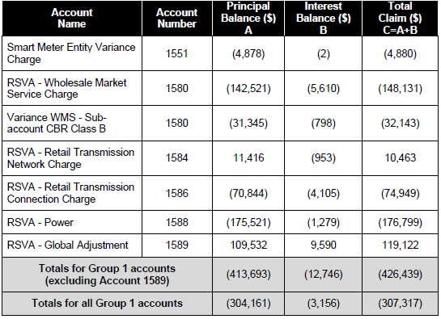
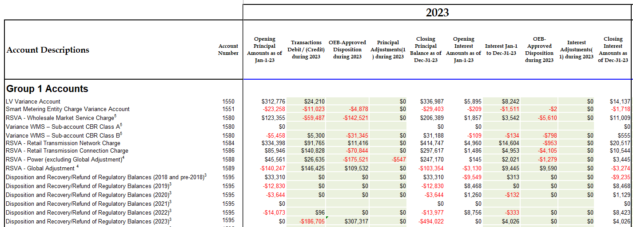
DVA Continuity Schedule (Cont.)
Observation 2: OEB approved disposition amount in Account 1595 does not match the amount on the Decision and Order, causing incorrect principal and carrying charge balance in Account 1595 Sub-account
Requirements
Per Chapter 2 Filing Requirements (section 2.9.1.3), when approval for disposition of DVA balances is received from the OEB, the approved amounts of principal and carrying charges are transferred to Account 1595 for that rate year
The approved principal should be transferred into principal column while the approved carrying charge should be transferred into approved interest column
2023 Decision and Order
2023 Continuity Schedule

Slide 33
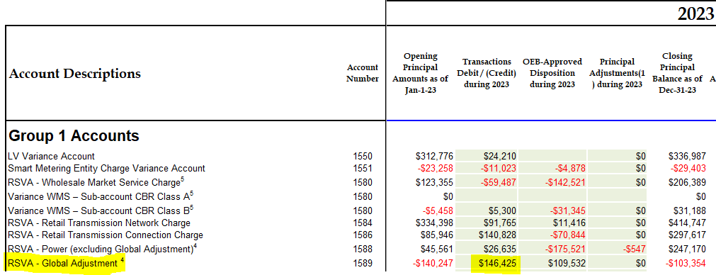
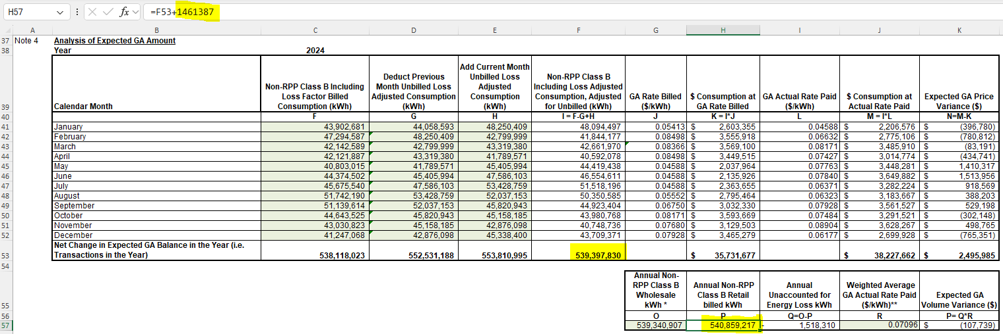
GA Analysis Workform – GA Tab
Observation 1: Data input errors, causing incorrect unresolved difference as % of expected GA payments to IESO
Requirements
Per GA Analysis Workform (Commodity Accounts Analysis Workform) Instructions
“Net Change in Principal Balance in the GL” of Note 5 should equal “transactions during the year” on the DVA Continuity Schedule
The distributor should provide explanation of changes made with built-in formulars
DVA Continuity Schedule
GA Analysis Workform Note 4
GA Analysis Workform Note 5

Slide 34
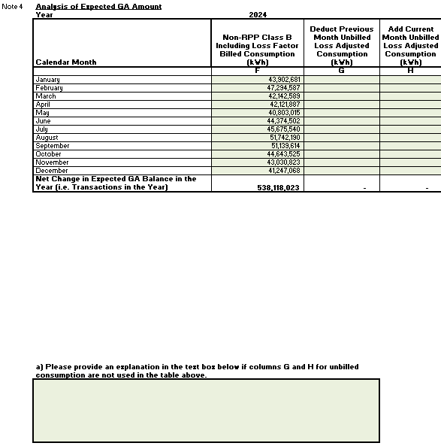
GA Analysis Workform – GA Tab (Cont.)
Observation 2: The workform is either missing information or is incomplete, causing incorrect unresolved difference as % of expected GA payments to IESO
Requirements
Per GA Analysis Workform (Commodity Accounts Analysis Workform) Instructions
The explanation needs to be provided in the text box under Note 4 if Column G and H are not filled
If there are prior years’ adjustments, the distributor needs to fill in Item (1a), (2a) and (3a) under Note 5
The distributor should indicate “Yes/No” in Column I under Note 5
GA Analysis Workform Note 5
GA Analysis Workform Note 4

Slide 35
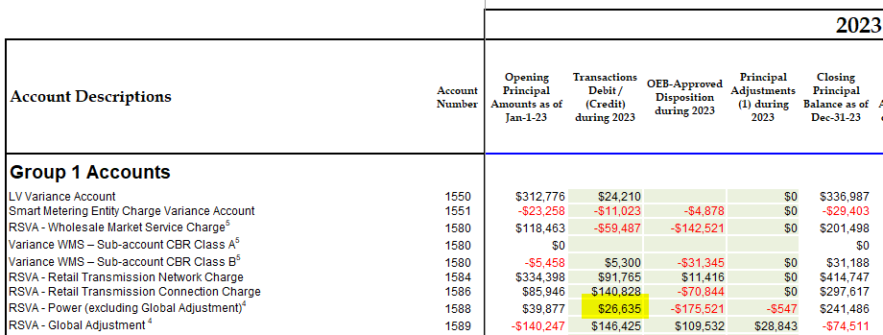
GA Analysis Workform – Account 1588 Reasonability
Observation 1: Data input errors, causing incorrect unresolved difference as % of Account 4705
Requirements
Per GA Analysis Workform (Commodity Accounts Analysis Workform) Instructions
The transaction amount should equal the "Transaction" column in the DVA Continuity Schedule which is also expected to equal the transactions in the general ledger
The distributor needs to provide the reasons under Note 7(a) if Account 1588 as % of Account 4705 is greater than +/- 1%
DVA Continuity Schedule
GA Analysis Workform Note 7

Slide 36
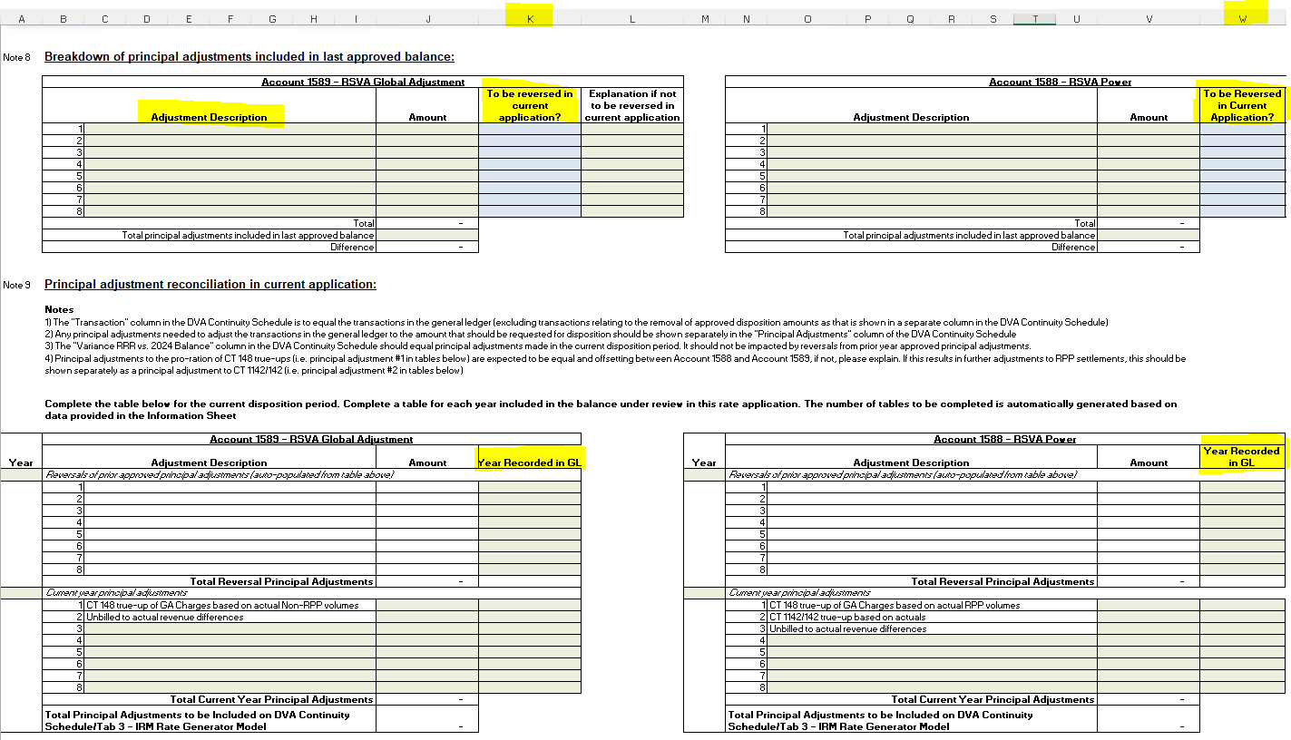
GA Analysis Workform – Principal Adjustments Tab
Observation 1: Missing information and incomplete workform, resulting in incorrect balances being disposed and risk of retroactive adjustments in the future applications
Requirements
Per GA Analysis Workform (Commodity Accounts Analysis Workform) Instructions
The distributor should ensure that the guidance pertaining to principal adjustments is followed
The distributor should ensure the preparation of the Commodity Workform aligns with the instructions regarding reconciling items and principal adjustments
GA Analysis Workform Note 8 & 9

Slide 37
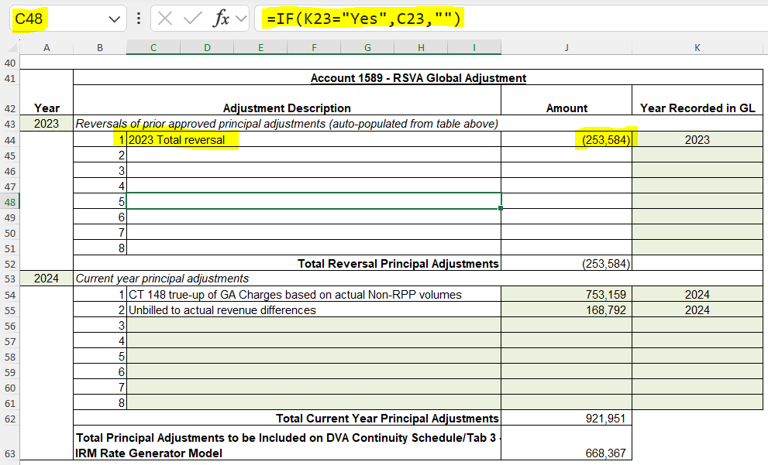
GA Analysis Workform – Principal Adjustments Tab (Cont.)
Observation 2: Data input error, resulting in risk of incorrect balances being disposed
Requirements
Per GA Analysis Workform (Commodity Accounts Analysis Workform) Instructions
Auto populated reversals of prior period principal adjustments should not be changed without explanation. These items should be separated according to their original description and amount
The distributor should provide explanation of changes made with built-in formulars
GA Analysis Workform Note 8
GA Analysis Workform Note 9

Slide 39
Thank You

