Slide 1
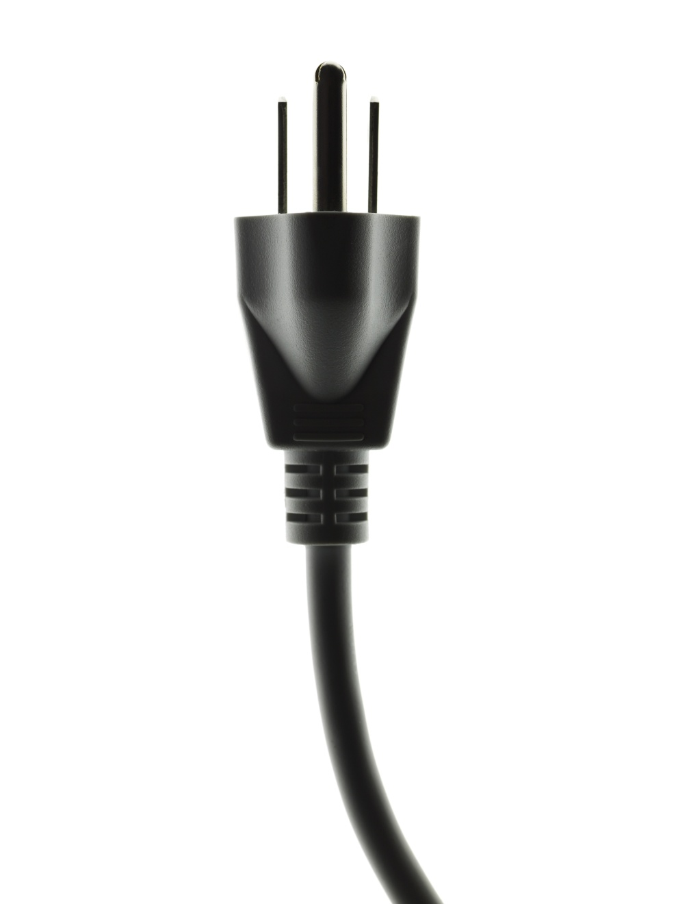
Smart Grid
Security/Privacy Overview
March 14, 2011

Slide 2
Introduction to the Smart Grid

Slide 3
General Characteristics of a Future Smart Grid
  “The Smart Grid is not an altogether ‘new’ grid and infrastructure as much as it is the overlay of a communications network on top of the electric distribution / transmission network and an upgrade of the existing electric delivery system with advanced monitoring sensors, control mechanisms, and some new transmission / distribution circuits to enable improved reliability, improved uptime, improved asset management, improved customer choice, and the integration of distributed generation and storage technologies.”
Elements of a Smart Grid
Electric Network
Demand for Electricity
    Digital information and controls technology
    Dynamic grid and resource optimization
    “Smart technologies” (real-time, automated, and interactive)
    Demand response, demand-side management and energy efficiency
    Smart appliances and consumer devices
Consumers
Supply of Electricity
    Provision of timely information and control options
    Standards for appliances and equipment connected to the grid
    Distributed resources and generation
    Advanced electricity storage and peak-shaving technologies

Slide 4
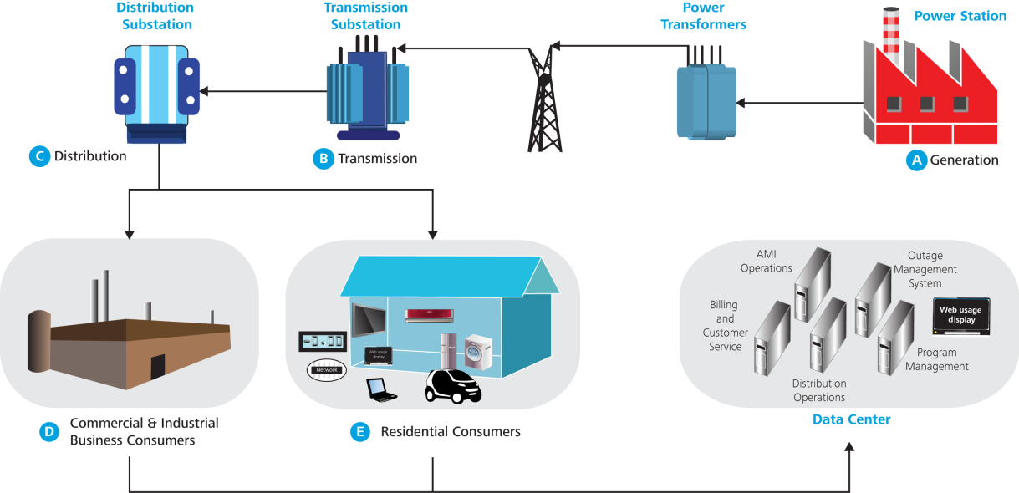
Getting Smart About the Grid
What is Smart Grid?
A smart grid updates the traditional electricity grid to enable new capabilities, such as load control. Smart grid adoption includes the replacement of legacy meters with an advanced meter infrastructure, which is enabled through a communication network.
Smart grid implementation creates additional security and privacy risks
This pervasive and massive deployment of networked components, ranging from thousands of smart meter sensors and other IT-enabled components that captures and stores user data, makes security issues daunting. Smart grid adopters are experiencing many of the same security and privacy issues that were experienced with the adoption of wireless networks and devices.
Smart grids use intelligent information exchange systems and equipment that support bidirectional communication of information and electricity

Slide 5
Value Proposition:
Improved reliability + security greener and more efficient energy markets
  Smart Grids allow energy companies to remotely manage their networks (generation, transmission, and distribution), providing the following main benefits:
    Power reliability and quality (fewer blackouts, cleaner power and self-healing systems)
    Safety and cyber security benefits (continuous monitoring and response)
    Energy efficiency benefits (load power control based on real-time demands)
    Environmental and conservation benefits (fewer greenhouse gases and pollutants)
  Smart Meters are the key components in providing the aforementioned benefits of a Smart Grid network. Meter sophistication has evolved over the years as new types of Meters have been introduced:
    Meter Reading: Manual reading meters based on a utility employee physically and locally reading and registering meter status data
    Automatic Meter Reading (AMR): First-generation of semi-smart, one-way meters
    Advanced Metering Infrastructure (AMI): Second-generation of truly smart meters with continuous monitoring and two-way communications between Smart Meters and the Central System

Slide 6
Secure Smart Grid Security Issues and Opportunities
BUSINESS PROBLEM
  The adoption of Smart Grid brings communications, services and new capabilities, but also creates new risks to security and privacy
  Organizations are not effectively positioned to protect critical infrastructure and data
  Cyber crime is increasing in volume and sophistication; an incident could be catastrophic
OPPORTUNITIES
  Identify security and
  privacy vulnerabilities through actionable risk-based approach
  Develop a security
  policy and technical architecture compliant
  with federal mandates
  Implement scalable
  processes and
  technologies that safe
  guard each end point
  Reduce the amount of time necessary to detect and address potential threats

Slide 7
Security and Privacy are not the same thing
Regulatory agencies
Data exchanges
Massive, new volumes customer information are generated
New critical infrastructures are relied upon
Information and energy are
bidirectional
Internet service provider
Wireless Carriers
Energy service provider
CRITICAL
INFRASTRUCTURE
Third-party entities
DATA
Metering technology
Grid operations
Information Systems; Billing and reporting
Device Control Data
Demand-side management
Electric Distribution
Network
operations
Account Transactions
Gas Distribution
Utility Operations
Demand Response
Water
Wide
Area
Network
Local
Powerline
Carrier
Customer Usage
Distributed Generation
Compliance Data
Internet Service
Transmission & Distribution
Marketing Data
Renewables Generation
Wireless Network
Privacy
Smart Meter
Endpoints
Security
EV
Internet
Customers
Smart Grid-enabled utilities are telecommunications companies, not just energy providers

Slide 8
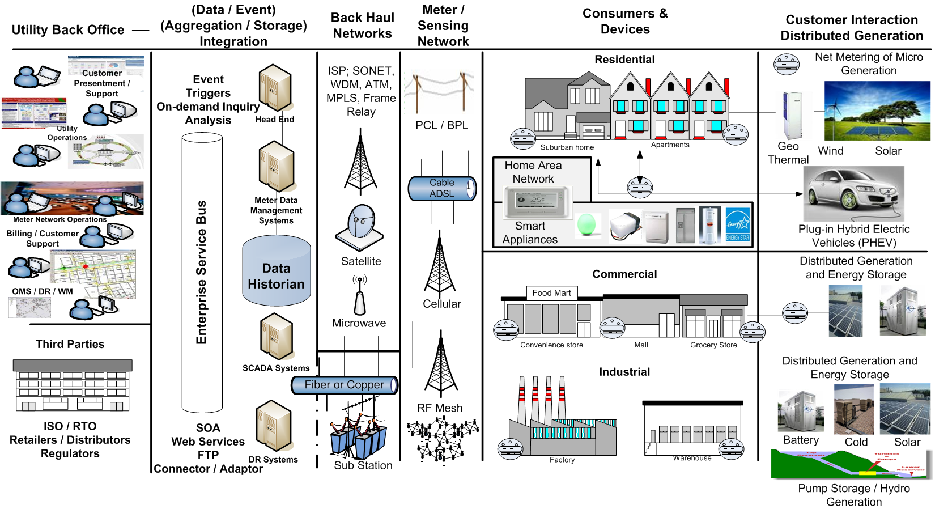
Smart Grid enables increased digital information, 2-way communication, and controls technology use to serve consumers, utilities, regulators, shareholders, and 3rd parties
Back Office – Billing, Control,
Data/Info Mgmt, Forecasting
Back Haul
Advanced Metering Infrastructure
Backhaul

Slide 9
The Smart Grid Threat Landscape

Slide 10
Key Threats and Vulnerabilities

Slide 11
Top Ten Smart Grid Considerations
  Two Way Communication and Trust
    Between devices under direct physical control of a utility and devices outside of the utility’s physical control as well as extending trust to those devices that are owned, but not controlled, by a distribution utility
  2. Smart Meter Security is an Unknown Quality
    Proper configuration and deployment to determine the expansion and addition of so many endpoints to the utility’s network does not pose an unacceptable risk
    Pre-deployment penetration testing by a third-party (not the vendor or utility) will be key to understanding the potential threats introduced when new devices are attached to the utility’s network
  3. Understand Customer Privacy of Data Collection Using Smart Meters
    Understanding what data is collected, and then explaining to the utility’s customers how the data is collected, retained, used, and secured
    Understanding the obligations and regulatory requirements of customer privacy related to the data collection activities, methods, storage, retention, and other aspects of customer data collection and storage
  4. Smart Meter Management
    Developing scalable and extensible network architectures and management of systems and procedures to support the management of smart meter endpoints on a large scale
    Development of emergency operations procedures, regular updating and emergency patching of firmware

Slide 12
Top Ten Smart Grid Considerations
  5. Smart Meter Network Threat Modeling
    Understanding how different points on a utility's grid have different levels of vulnerability associated with them, such as ISO interconnections between transmission owners, remote distribution faculties, individual smart grid endpoints on the same data network and Home Area Network Systems
    Inherent risks of the communications technology used (owned frequency spectrum band may allow a fully-meshed network but with a high cost; existing cell data networks, not fully-meshed but cheaper; PLC communications might be cheaper, but attenuations are a disadvantage)
  6. Smart Grid Meter Security Monitoring
    Understanding how to perform the detection of anomalies such as penetration attempts, unauthorized access, out of profile behaviours of a meter, theft of service attempt, and other similar activities
  7. Cost of Adding Security Later to Smart Meter Developments
    Operational security of the environment is addressed in any deployment using proper methods such as network segregation, access controls, and secure configuration of endpoints
    Secure development of firmware and communications protocols are used and compared using third parties and proper testing methodologies such as code review automation, ethical hacking, and other similar activities
    While securing transmission and generation are critical, distribution/demand need to be secured up-front to help control costs

Slide 13
Top Ten Smart Grid Considerations
  8. Understanding Regulatory Requirements and Standards of Smart Grid
    Over 77 pertinent standards for Smart Grid
    5 of these standards (NERC, IEEE, AMI System Security Requirements, Utility/AMI Home Area Network System Requirements, and IEC Standards) apply to Smart Grid security
  9. Using Existing Security Systems to Secure Smart Grid Deployments
    Unification of a security landscape viewpoint to provide a single common security management plane
    Understanding the threats in the demand space holistically and how they potentially relate to transmission and generation
  10. Shifting Focus from Preventative Security to Detective Security
    The success of Stuxnet demonstrates a gap in defective controls
    While delineation of control and data-acquisition networks are critical, the focus needs to be on detective controls, sensors, and anomaly detection rather than building hard perimeters through firewalls and intrusion prevention systems
    Create a layered security model, and apply detective techniques in each so-called “interface.” Detect if any attacks reach as far up as the main and core systems

Slide 14
Mitigation Strategies

Slide 15
Implications – Specifications, Standards, and Policy Drive Investment Costs
Key Consideration of Leading Security Practices
Smart Meter Device Security
Communications
Head-end
Collector
COTS/Open
Source Systems
Evolving Security Standards
Focus Area
Encryption
Layered Defenses
R&D Investments
Real-time Monitoring
Shared Situational Awareness
System of Systems Integration
Trusted Hardware & Software
Source: Deloitte Consulting analysis.

Slide 16
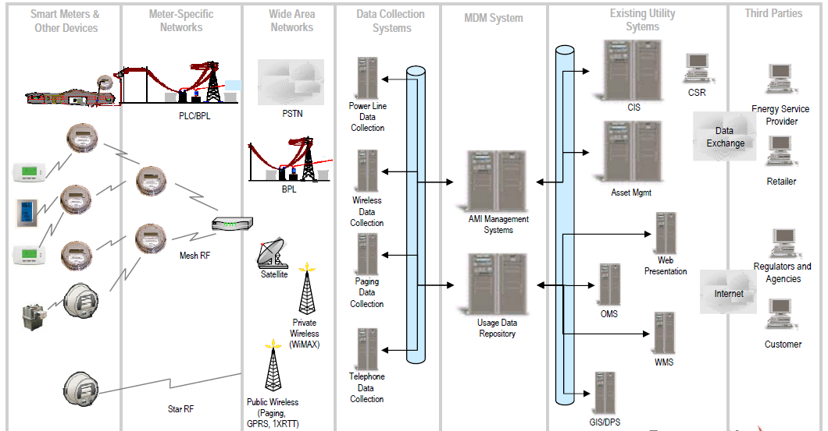
A Smart Grid Risk Assessment uses a zoned-based approach that extends the security perimeter to envelope customers, utilities and third parties.
Zone 1
Zone 2
Zone 3
Zone 4
Zone 5
Zone 6
Zone 7
Source: Deloitte Consulting, Lockheed Martin analysis.

Slide 17
Risk Assessment Framework - identify, assess, and mitigate threats / vulnerabilities
Assessment
Current State
Zone Risk Analysis
Risk Response
Risk Decision
Planning
Assessment
Documentation
u
Project
Ž
System

High
‘
’
-
level Risk
Risk Mitigation
Management
Scoping
Characterization
Analysis
Options
Reporting
4
Confirm Project
Identify AMI
Identify General Control
Establish the High
-
Stakeholders, Scope, &
4
Architecture and Zones
4
Environment
4
Control Options for
level
4
Perform Risk Roll Up and
Approach
Identify Business,
Reducing Risk
Reporting
4
4
Conduct Interviews
Develop a High
-
4
Identify Reporting
Regulatory and Legal
Establish Zone Risk and
Recommend Control(s)
4
level
Requirements
Drivers
4
Tolerance Rating
4
and Alternative Solutions
Recommendation
Line Up Interviews,
Identify Data Flow
Roadmap
4
Request Access to Key
4
And Privacy Analysis

Detailed
level
4
Identify Areas Where an
4
Document and Present
Data and Personnel
Risk Analysis
Immediate Response is
Findings and
4
Identify Business Assets
Required
Recommendations to
& Controls within zones
4
Identify Threat
4
Establish the Risk
Management
4
Identify Business Asset
Vulnerabilities
Mitigation Preferred
4
Obtain Management
Criticality & Sensitivity
4
Perform Testing
Option
Approval
4
Schedule Specific
Testing, Analysis, and Interviews
–
Penetration Testing
–
Reduce Risk,
v
Analysis
–
Vulnerability Scans
–
Avoid Risk
Framework
–
Patch Reviews
–
Accept Risk
4
Conduct Kick-Off
–
App Scans
–
Transfer Risk
4
Establish Definitions
4
Conduct Reviews of:
4
Finalize Control(s)
Define Analysis Process
–
Infrastructure
Approach based on Risk
4
–
Middleware & Apps
Mitigation Option
4
Establish Risk Scenarios,
–
Providers
Selected
Impact, Likelihood, Risk
Identify and Analyze
4
Establish the Residual
Rating, and Risk
4
As
Risk Rating
-
Tolerance Criteria
Is
Zone Controls
4
Collect and Review
System and Process
Documentation
4
Identify Likelihood and
Impact
4
Establish Zone Risk and
Source: Deloitte & Touche
Tolerance Rating

Slide 18
Notes:
18

