Slide 1

Implementation of Operational Improvement Initiatives for the 2014 Electricity Distributor Scorecard
The audio portion of the meeting will be delivered via telephone
To access the conference line call:
416-340-2217 or Toll Free 1-866-696-5910
Access number: 2923198
To submit questions during this presentation please use the “chat” feature:

Slide 2
Implementation of Operational Improvement Initiatives for the 2014 Electricity Distributor Scorecard
Industry Operations and Performance
Audit and Performance Assessment
June 4, 2015

Slide 3
Introduction
Throughout the 2013 scorecard implementation process, the OEB received concerns, feedback and improvement suggestions related to the scorecard from electricity distributors.
As part of its commitment to continuous improvement regarding scorecards, the OEB formed a working group in January 2015 to make improvements to the scorecard process.
Staff from the Audit and Performance Assessment department (OEB Staff) and members of the Working Group worked on implementation issues and met a number of times between February and May 2015 to fulfill the mandate.

Slide 4
The Working Group’s mandate
Scope of the Working Group of 2014 Scorecard Implementation
To work with the OEB staff to review concerns and issues arising from the experience and lessons learned from the 2013 scorecard process, and to develop improvements for the implementation of the 2014 scorecards in 2015.

Slide 5
The Working Group of 2014 Scorecard Implementation Process
  CHEC Group
    Orangeville Hydro
    InnPower Corporation
    Midland PUC
    Niagara-on-the-Lake Hydro
  Entegrus Powerlines
  Hydro One Networks Inc.
  Hydro Ottawa Ltd.
  Guelph Hydro
  Kingston Utilities
  North Bay Hydro
  PUC Distribution Inc.
  PowerStream
  Toronto Hydro
  EDA – Observer
  ESA - Observer
Four sub-committees of the Working Group were formed to address specific areas:
RRR Filing Guide,
Benchmarking Process Improvements,
Scorecard Management Discussion and Analysis (MD&A)
Scorecard Communications Best Practices

Slide 6
Improvement Initiatives to the 2014 Scorecards
OEB letter of April 30, 2015 outlined the implementation of improvement initiatives for 2014 electricity distributor scorecard.
Key improvements have/will be implemented in 2015 for the 2014 scorecard process.
  Reporting & Record Keeping Requirement (RRR) Filing Guide
  Enhanced Benchmarking Spreadsheet Model and User’s Guide
  Enhanced Scorecard Regulatory Calendar
  Scorecard MD&A Guide and Scorecard MD&A template
  The Scorecard Communications Guide
  French Presentation of the Scorecards
  Scorecard Public Safety Measure
  Enhancements to the OEB’s e-Filing Services Webpage

Slide 7
May 22, 2015 OEB Letter for Issuance of the 2014 Scorecard Documents
The OEB accepted the recommendations made by the OEB Staff and Working Group regarding the OEB Staff prepared Scorecard MD&A Guide, Scorecard Communications Guide, and enhanced Scorecard Regulatory Calendar for the electricity distributors.
All of the guides and documents are available on the OEB’s website.
Over the course of the coming year, the OEB will monitor the effectiveness of the 2014 scorecard implementation process. Where and if necessary, the OEB will determine if these guiding documents need to be strengthened and issued as formal OEB requirements.

Slide 8
Webinar Agenda
 | Time | Topic | Presenter
1 | 9:30 am – 9:40 am | Welcome & Introduction | Daria Babaie - OEB
2 | 9:40 am – 9:50 am | Improvement Action Plans to Address 2014 Scorecard Issues/Concerns/Opportunities | Dominic Parrella – PUC Distribution Inc. Christine Bell – Midland PUC
3 | 9:50 am – 10:00 am | Enhanced Regularly Calendar (Timelines) for Implementation of 2014 Scorecard | Ben Baksh - OEB
4 | 10:00 am – 10:20 am | Scorecard MD&A Guide | Daria Babaie – OEB Pankaj Sardana - Guelph Hydro
5 | 10:20 am – 10:45 am | Scorecard MD&A Examples | Chris Cowell – Entegrus Powerlines Louise Gauthier – PowerStream Carm Altomare – Hydro One
6 | 10:45 am – 11:05 am | Scorecard Communications Guide | Dmitry Balashov – Toronto Hydro Laurie Elliott – Hydro Ottawa
7 | 11:05 am – 11:10 am | EDA Communication Tools | Afreen Khan - EDA
8 | 11:10 am – 11:15 am | French Presentation of the Scorecards | Karen Evans – OEB
9 | 11:15 am – 11:20 am | Enhancement to the OEB Portal | Susan Muckle – OEB
10 | 11:20 am – 11:50 am | Scorecard Public Safety Measure | Normand Breton - ESA
11 | 11:50 am – 12:00 pm | General Questions and Wrap-up | Daria Babaie – OEB

Slide 9
Feedback from Meeting with the EDA Communicators Council on May 27, 2015 Regarding the Scorecard Communications Guide
Dmitry Balashov – Toronto Hydro
Laurie Elliott – Hydro Ottawa

Slide 10
Feedback from Meeting with the EDA Communicators Council on May 27, 2015 Regarding the Scorecard Communications Guide
Overall, the feedback from the meeting with the EDA Communicators Council on May 27, 2015 regarding the Scorecard Communications Guide was positive.
Members of the EDA Communicators Council found the 3 minimum requirements of (1) the scorecard prominently be visible on the homepage of the distributor’s website, (2) the distributor to alert customers of scorecards at least once year through a bill message, and (3) the distributor to ensure front line staff who interact with customers are sufficiently knowledgeable of the scorecard to confidently refer to it, as opportunities arise.

Slide 11
Feedback from Meeting with the EDA Communicators Council on May 27, 2015 Regarding the Scorecard Communications Guide
Members the EDA Communicators Council showed interest to work with the OEB staff and members of the 2014 scorecard implementation working group to develop standard scorecard communications templates and scorecard communications survey questions to be available to all distributors to ensure consistency in communications practices among distributors.
Members the EDA Communicators Council to provide input to the OEB staff regarding feedback from distributors’ customers on their respective 2014 scorecard, post-publication.

Slide 12
Questions & Answers
To submit questions please use the “chat” feature.

Slide 13

EDA Communication Tools
Electricity Distributors Association
Afreen Khan
June 4 2015
www.eda-on.ca

Slide 14
EDA Communication Tools
EDA’s provided input during the OEB Scorecard consultation process in 2013 primarily through its Regulatory Council
The EDA’s Regulatory Council, comprised of 24 LDC members, focuses on the regulatory issues of LDCs related to determination of rates, regulatory instruments, processes and proceedings and other regulatory issues
OEB staff can present the improvements at EDA’s Regulatory Council- attendance is usually 30+ LDC members
EDA can also co-host webinars with the OEB, similar to one held in December 2013

Slide 15
Communication Tools continued
EDA regularly communicates to LDC members through e-communications on critical information and updates
EDA can issue RapidSources as and when required that target LDC members only, informing them of time-sensitive updates re: the scorecard
EDA also issues the Weekly every Wednesday that reaches LDCs, some commercial members, the government and other stakeholders
EDA has issued three EDA Weekly articles since the OEB has been releasing updates re: the scorecard

Slide 16
Questions & Answers
To submit questions please use the “chat” feature.

Slide 17
French Presentation of the Scorecards
Best Approaches Discussion
Karen Evans
OEB

Slide 18
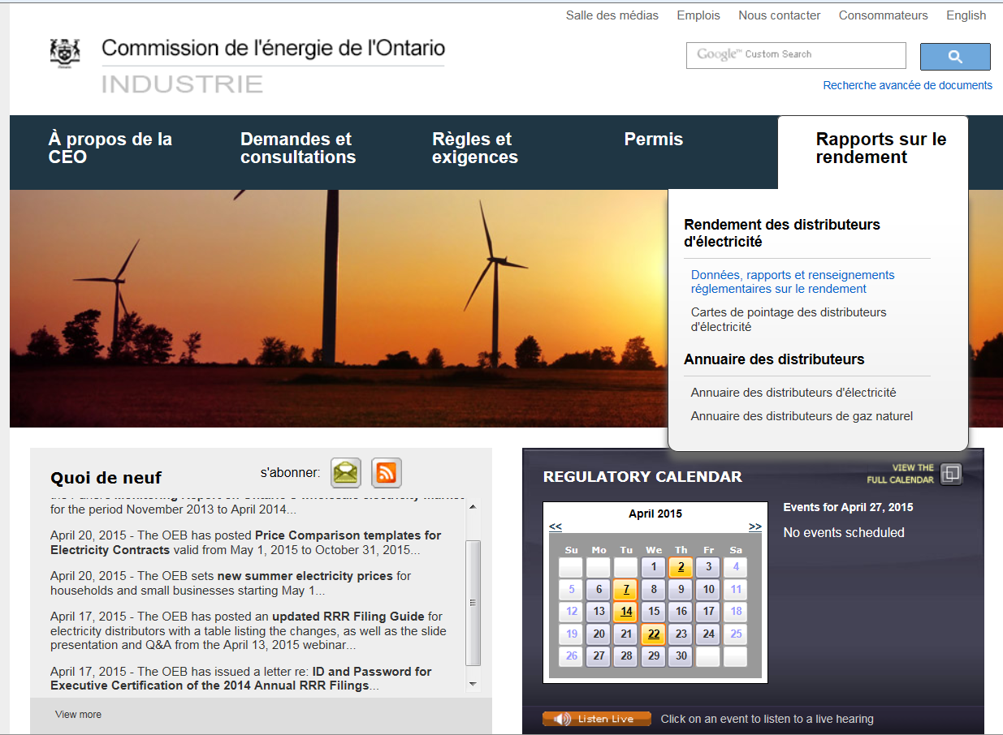
Current Online Scorecard Format – French presentation

Slide 19
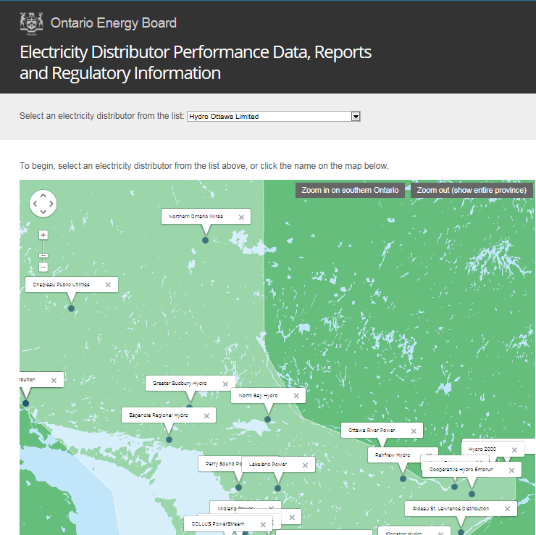
French Page – formerly English Presentation

Slide 20
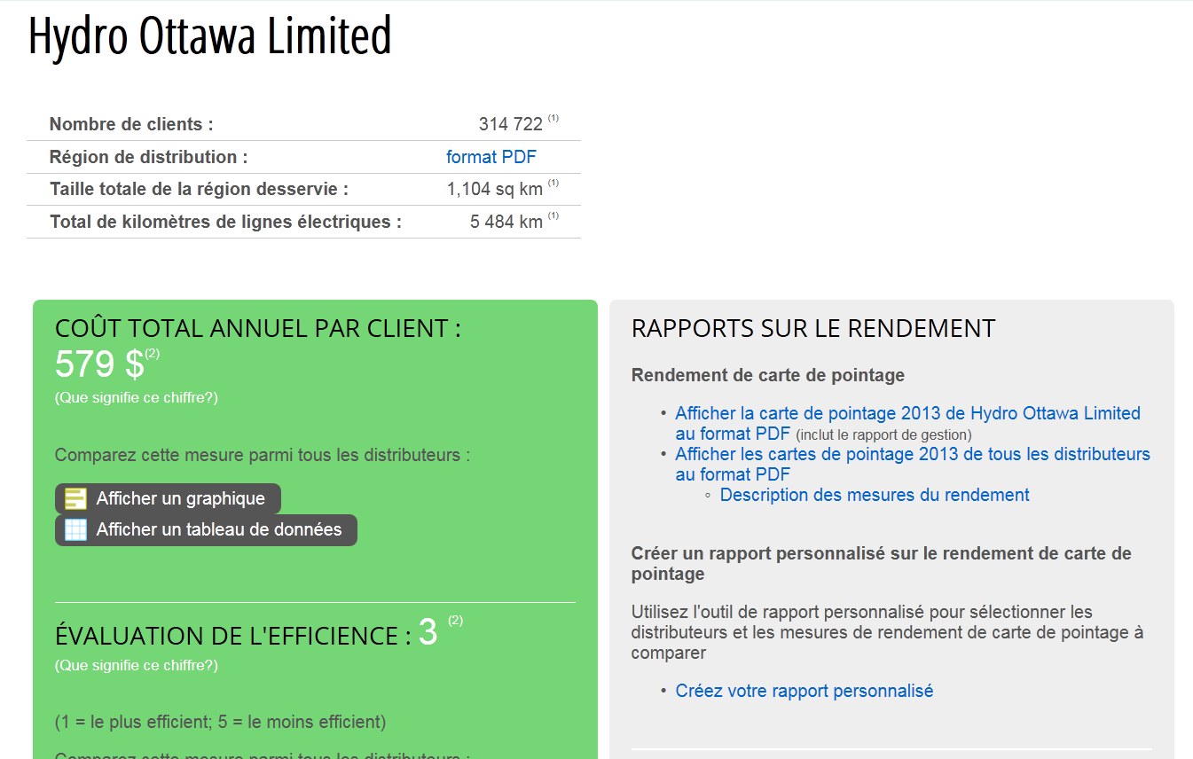
French Page – Now, French Presentation

Slide 21
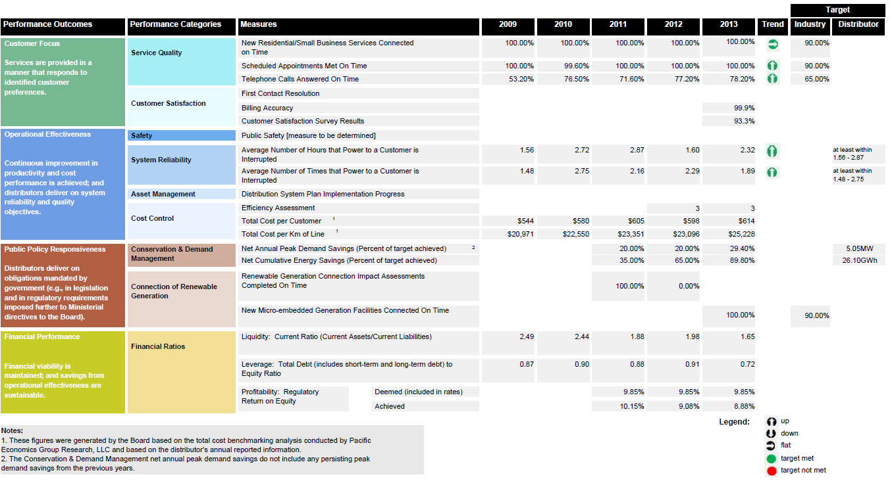
French Page – French Presentation
All scorecards (performance results section – Page 1) will be translated to French.
OEB to do translation and publish in September

Slide 22
Translations – MD&A
LDCs with French customers will translate their Scorecard MD&A and send to OEB.
OEB will integrate Page 1 and Scorecard MD&A and post on OEB website (September)
MD&A

Slide 23
Scorecard Changes Discussion
Scorecard MD&As will be posted in English-only for LDCs that typically don’t translate.
OEB will add a note on the web:
Aussi disponible en français
If a customer wants a translated document, OEB will provide it (translation and payment).

Slide 24
Questions & Answers
To submit questions please use the “chat” feature.

Slide 25
Enhancement to the OEB Portal
Susan Muckle
OEB

Slide 26
OEB Portal
Issue: CEO not available for Scorecard sign-off – enable CEO to delegate to officer of the company for Sign-off in advance of deadline.
Improvement:
A letter was issued on April 17, 2015 with details on how to obtain ID/password for executive certification regarding 2014 annual RRR Filings and sign-off for the scorecards:
  The OEB requires the company to complete the Electronic User Form and submit its request electronically to the OEB’s Board Secretary Office by April 24, 2014.
The electronic User Request Form has been updated on the OEB website to accommodate requests for executive certification
New electronic form to allow CEO to delegate Scorecard signing authority to an existing User with access for executive certification.

Slide 27
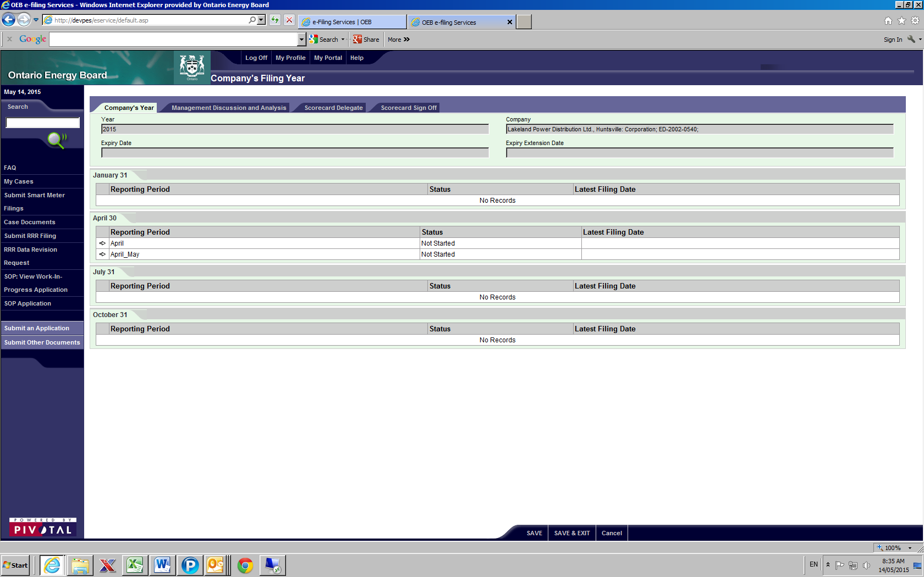
OEB Portal
On the Reporting Year for the Company, select Scorecard Delegation tab

Slide 28
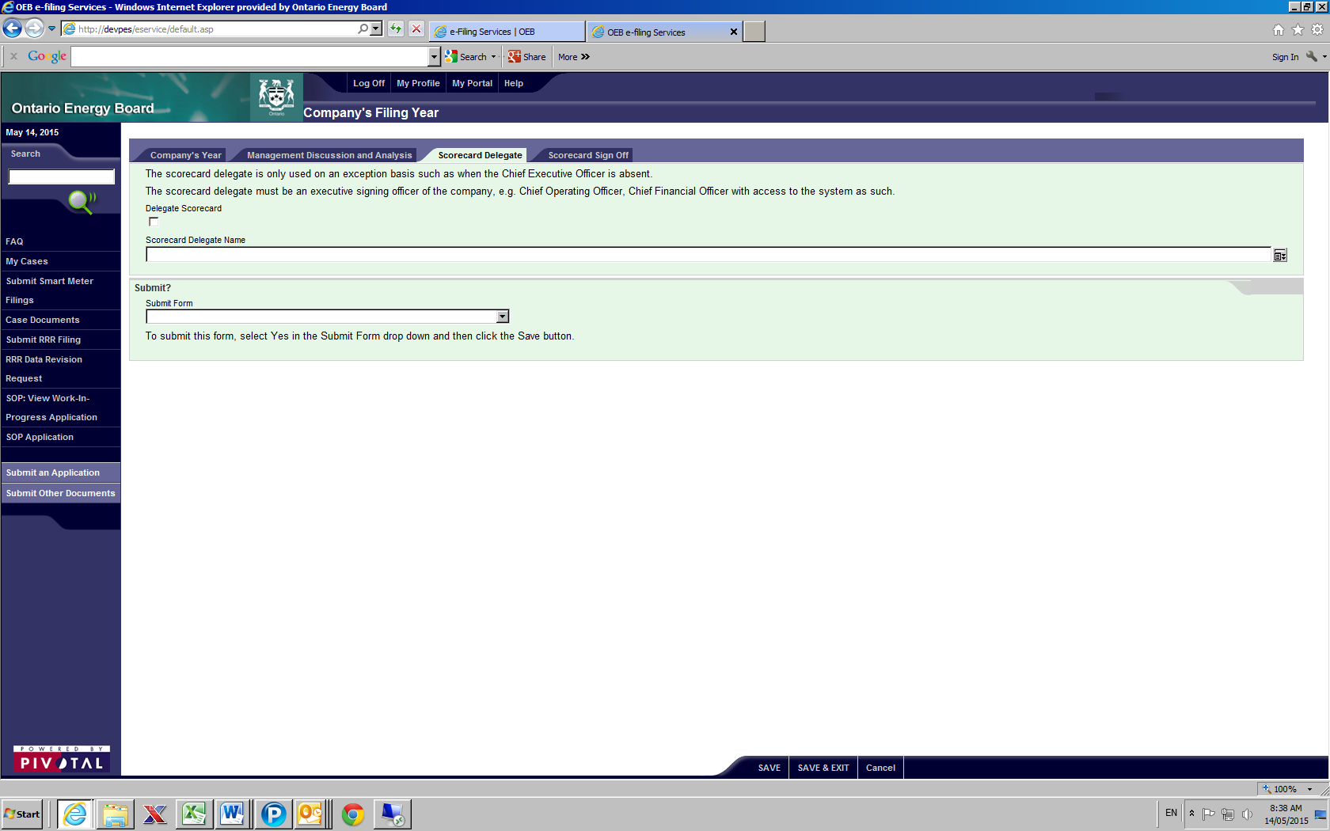
OEB Portal
CEO is the only RRR access that can use this function

Slide 29
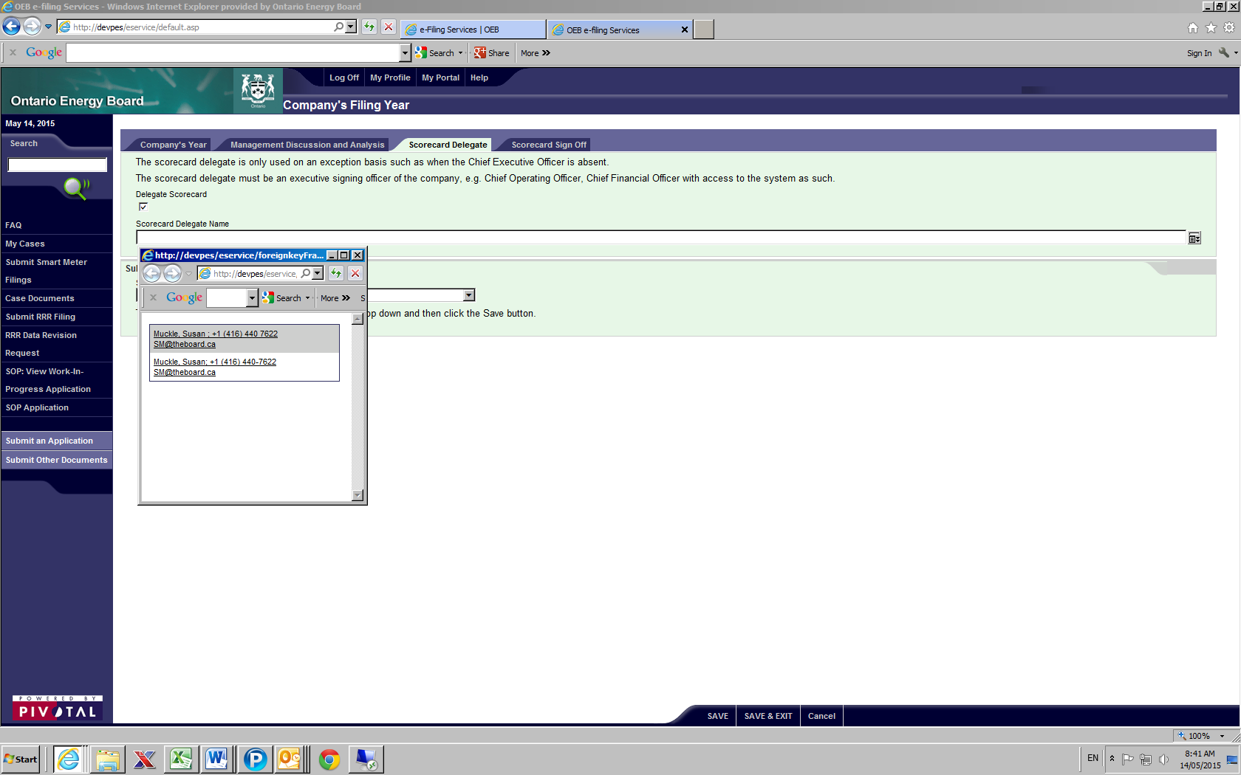
OEB Portal
Once the Delegate Scorecard is checked off, the names of those with executive signing such as Chief Financial Officer appear. Select the person’s name and submit as Yes.

Slide 30
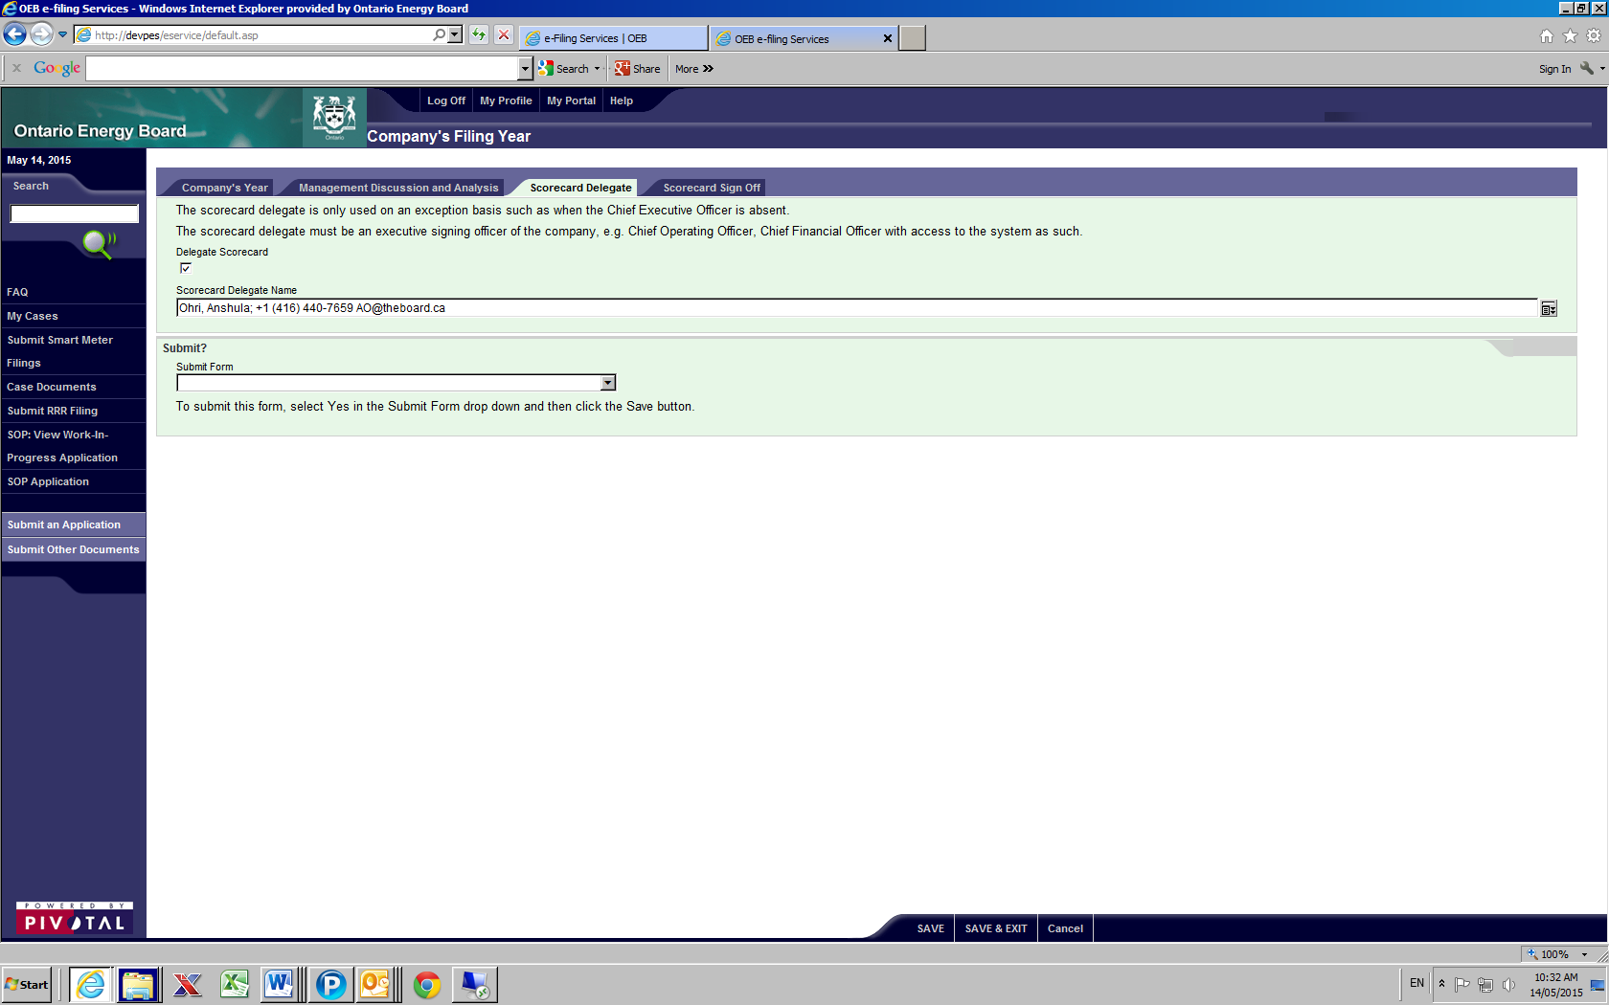
OEB Portal
This is the new Scorecard Delegate Name that was selected. The person named will login and select Scorecard Sign Off.
p

Slide 31
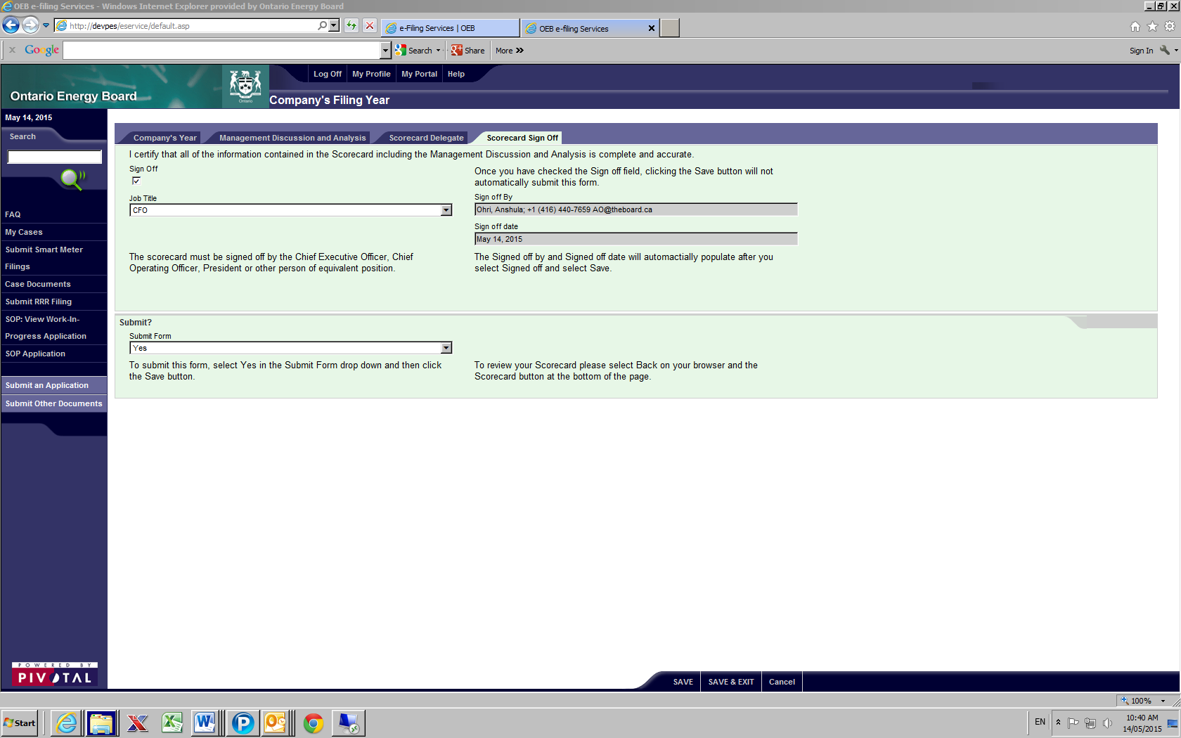
OEB Portal
The delegate clicks the Sign Off and Job Title and Saves. The delegate’s name is filled in to the Sign Off By and the Date. To submit the signoff, change the Submit Form to Yes and Save or Save & Exit.

Slide 32
OEB Portal
Issue: Distributors’ workstations not set up with pre-requisites to view/print scorecard. Delegate needs to have workstation set up as well.
Improvement:
Distributor to ensure their workstations are set up to view/print scorecard.
Computer technical requirements (including for printing) are on the e-Filing services webpage http://www.ontarioenergyboard.ca/oeb/Industry/Regulatory%20Proceedings/e-Filing%20Services

Slide 33
OEB Portal
Issue: Automatic log out of portal after period of time and could lose data.
Improvement:
Portal now stays open for 2 hours of inactivity.
A warning message before 2 hour window expires implemented on May 2, 2015.

Slide 34
Questions & Answers
To submit questions please use the “chat” feature.

Slide 35
LDC Scorecard - Public Electrical Safety
Measure
LDC Briefing
June 04, 2015

Slide 36
Purpose
To provide an update on the Public Electrical Safety portion of the LDC Scorecard

Slide 37
Recommendation
To monitor both the effort and impact LDCs are having on improving public electrical safety ESA recommended to the OEB in April 2015 a scorecard public electrical safety measure that includes the following three parts:
The level of public awareness within an LDC’s territory
of the electrical safety information and precautions related to the
distribution network assets;
The level of LDC compliance with Ontario Regulation 22/04 ,
Electrical Distribution Safety;
The number and rate of serious electrical safety incidents
occurring on LDC’s assets per year as already defined by
Ontario Regulation 22/04.

Slide 38
Part A - Public Awareness
  Purpose:
    measure levels of awareness of key electrical safety precautions among public within LDC service territory
  Methodology:
    bi-annual survey of statistically representative sample of territory’s adult population
    standardized questions & answer scoring to produce awareness index for each LDC’s scorecard
    As per OEB approach for a new scorecard measure, after three rounds of data collection targets can be set

Slide 39
Part B – Level of Compliance
measure the level of LDC compliance to Ontario Regulation 22/04
Electrical Distribution Safety
Methodology
annual audit of compliance submitted by LDC (sections 4-8)
annual declaration of compliance submitted by LDC (sections 3, 9-12)
reports evaluated (DDIs, Audits, Public Safety Concerns )
outcome (compliant, needs improvement, non compliant)
Target:
LDCs to be fully compliant with Regulation 22/04
  Purpose:

Slide 40
Part C - Serious Electrical Incident
Index
  Purpose:
    measure the number and rate of serious electrical incidents occurring on an LDC’s assets per 10, 100 or 1,000 km of line
  Methodology:
    number of non-occupational (general public) serious electrical safety incidents involving LDC owned assets ≥ 750 V each year
    number is standardized to a rate per 10, 100 or 1,000 km of line (underground and overhead)
    both the actual number and the rate per km of line will be reported each year
    Target:
    LDC specific rate based upon LDC’s prior performance

Slide 41
LDC Public Safety Measure Process
Selection of Working Group
Working Group Meetings
Oct 21 – Nov 18
ESA Executive Management Team (Nov)
ESA Board of Directors
(Dec)
Utility Advisory Committee (Dec)
Multi-Stakeholder Consultation
(Jan - March)
Final Measure – ESA Board
(March)
OEB Board Update
(Dec)
Regulatory Affairs & Governance Committee (Nov)
ESA Internal Project Team Meetings
Measure Refined
Measure Developed
(Nov)
Measure Refined
Detailed reporting
Working Group (April)
Recommendation to OEB (April)

Slide 42
Stakeholder Consultation
Working Group sessions with LDC and consumer reps
Broad stakeholder consultation on draft measures
Working Group regroup to review to review consultation comments and provide final feedback
Finalized recommendation from ESA to OEB

Slide 43
Next Steps
ESA’s intends to move forward as follows:
2015:
Provide 2014 compliance and serious Electrical Incident data to each LDC and to the OEB by July 31, 2015
data to be vetted thru each LDC prior to final submission to the OEB by the ESA
    Finalize survey content with LDCs and researchers in 2015
    working group sessions Aug. – Sept
    stakeholder consultation Sept. - Oct.
    Deliver final survey content to OEB early Nov.
Subsequent years

Slide 44
Next Steps continued
    2016 and beyond:
    Finalize process to deliver annual safety data to LDCs which is acceptable to all parties
    Periodic review of survey effectiveness by ESA
    Updating of questions as needed by ESA
    LDC execution of public awareness survey
    Filing the 2015 results for the scorecard public safety measure (all three components ) with the OEB as a part of RRR annual filings.

Slide 45
Questions & Answers
To submit questions please use the “chat” feature.

Slide 46
Appendix

Slide 47
Q&A’s
Q1: The OEB released the Public Safety Scorecard letter. I understand that the results for component 2 and component 3 of the Public Safety Scorecard measure for the reporting period of 2010 to 2014 (5-year data) will be provided by the ESA to the OEB. But, what is the reporting process for the reporting requirement is in 2016 regarding the 2015 data?
A1: In the year of 2016, all electricity distributors are required to directly report the 2015 Public Safety Scorecard data to the OEB by April 30, 2016 through their annual RRR filings.

Slide 48
Q&A’s
Q2: Is it OEB’s expectation that distributors will survey their customers with the ESA’s public safety survey questions by the end of the current year in order to report in the 2015 scorecard?
A2: In the May 13, 2015 OEB letter regarding implementation of the Public Safety Scorecard Measure, the section for Component A – Public Awareness of Electrical Safety states, “The LDCs will execute the survey every two years. The ESA will complete the preparation work for the survey in 2015. The ESA will monitor the effectiveness of the surveys and update survey questions, if required. The OEB expects that the first reporting of this component of the public safety measure will be shown on the scorecards for 2015”.

Slide 49
Q&A’s
Q3: Can the LDC’s conduct the awareness survey in conjunction with other surveys such as a customer satisfaction survey ?
A3: No. The survey must be done with a representative sample of adults 18+ residing in the LDC’s territory not just customer contacts.
Note that the sample should be of adults 18+ living in the territory, not just ratepayers of the LDC. This is because the need for safety awareness re: LDC equipment extends beyond just the payee of the electricity bill.

Slide 50
Q&A’s
Q4: What methods or means are acceptable to conduct the awareness survey?
A4:The choice of survey methodology (e.g. telephone or online or mix) is left to the LDC as long as there is confidence in the representative nature of the sample.
English is required. LDCs may choose to execute in other languages in addition based on their customer base, and the value the results may provide for their local awareness efforts.
Core question wording and response scales will be provided to LDCs so as to produce consistent and comparable data, and to make survey execution easier.

Slide 51
Q&A’s
Q5: What portions of the public safety measure will be reported on the 2014 LDC scorecard?
A5: As per the OEB Public Safety Scorecard letter , the ESA will provide to the OEB the performance results regarding level of compliance with Ontario Regulation 22/04 (component #2) and serious electrical incident index (component #2) on behalf of distributors. However, the ESA will provide individual compliance and serious electrical incident data to each distributor for validation before sending this data to the OEB in July 2015. Thus, distributors will not be required to file these two measures directly with the OEB for the 2014 scorecards.

Slide 52
Q&A’s
Q6: How will the safety measure data be displayed on the LDC scorecard?
A6:There will be separate line items on the scorecard for each of the 3 components of the safety measure . The first line showing the awareness measure, the second line showing the compliance portion. For the safety index component, this will appear as two additional line items: the first showing the annual safety index measure number and the second showing the rate.

Slide 53
Q&A’s
Q7: Who will be responsible to provide the safety measure data to the OEB?
A7: As per the OEB Public Safety Scorecard letter of May 13, 2015, starting in 2016 all electricity distributors will be required to directly file the performance results on the public safety measure to the OEB as a part of their annual Reporting & Record Keeping Requirement (RRR) filings (i.e. due by April 30 of the following calendar year). The results will be reported under section RRR 2.1.19 (d) Public Safety. The electricity distributors are expected to work with the ESA regarding validation of the compliance and safety index data.

Slide 54
Q&A’s
Q8: When will the performance target be set for the awareness portion of the safety measure?
A8: As per the OEB Public Safety Scorecard letter May 13, 2015 the performance target for Public Awareness of Electrical Safety will be established once three years of data is gathered from the distributors.

Slide 55
Inquiries Regarding Scorecard Implementation and Related Documents
Any general inquiries regarding the 2014 scorecard implementation and related documents should be directed to OEB’s Industry Relations at:
  IndustryRelations@ontarioenergyboard.ca

