Slide 1
Activity and Program-based Benchmarking (APB)
Continuous Improvement
Industry Presentation
Scheduled for December 09, 2021

Slide 2
APB Background Information
EB-2018-0278: Activity and Program-based Benchmarking Initiative webpage
March 2021 APB report and corresponding MS Excel results
May 2021 stakeholder presentation
November 2021 letter

Slide 3
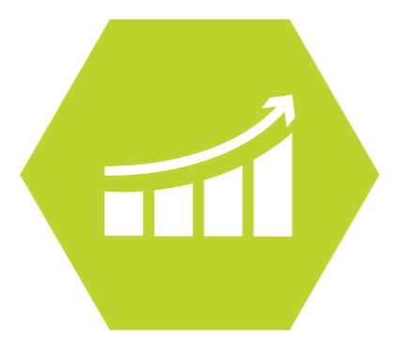
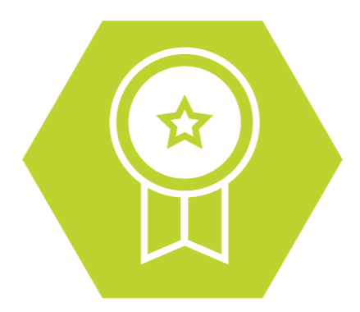
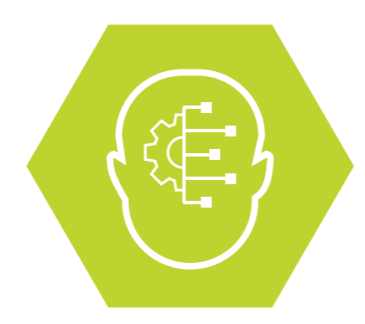
Why we are enhancing APB
In alignment with our goals from our Strategic Plan
Evolve towards becoming a top quartile regulator
Commitment to continuously evolving APB to help streamline regulatory application through reduction in filing requirements
Drive energy sector performance
A robust performance analysis tool driving efficiency by standardizing benchmarks across the sector
Facilitate innovation
Enable comparison across the sector to reveal opportunities for innovation

Slide 4
APB Continuous Improvement in 2021
Better repeatability of results by capturing enhanced cost drivers
Uniformity of cost drivers to facilitate accurate comparison of performance between utilities
Leveraging comparability to reduce utility burden in preparing application evidence
Robustly capture cost drivers
Results comparable between utilities
Information reduces regulatory burden

Slide 5
Proposed Path Forward
December: Industry webinar to discuss and hear feedback on proposed changes
APB Fiscal 2021/22
January: Adjust proposed methods based on feedback, update calculations with latest data
February: Announce new methods, updated results, and new RRR requirements to industry
March: Publish new report with updated calculations, including 2020 data
June: Update calculations with 2021
Data from April filing

Slide 6
Notes to the Reader
Data used to generate all “Current State” results is embedded in the charts (Right click → Edit Data)
OEB staff have updated all O&M program calculations with latest RRR data
  Some results may have changed due to utility revision requests submitted after March APB report was published
Staff’s analysis of results and feedback received from utilities is captured on each “Current State” slide along with incremental RRR needed for that specific formula on an ongoing basis
Staff’s proposed “Future State” slides summarize the benefits of the proposed change and incremental RRR needed for that specific formula on an ongoing basis
  In some cases, Staff’s proposed change reduces the incremental RRR needed on an ongoing basis

Slide 7
Billing O&M: Current State
${Unit Cost}_{ 2019}=$ $\frac{{USoA 5315}_{ 2019}}{{LDC Customers∗}_{ 2019}}$
Median: $27.50
Mean: $35.85
Std Dev: $22.09
+/- 50% of Avg: 36/59
Analysis & Feedback
Customers* excludes Sentinel/Street Lighting & USL Connections
Formula captures business drivers of cost as-is
Relatively good “gap” to delineate between low and high- cost utilities
New RRRs
None

Slide 8
Metering O&M: Current State
${Unit Cost}_{ 2019}=$ $\frac{{USoA (5065+5175+5310)}_{ 2019}}{{LDC Customers∗}_{ 2019}}$
Median: $17.43
Mean: $19.86
Std Dev: $11.75
+/- 50% of Avg: 42/59
Analysis & Feedback
Customers* excludes Sentinel/Street Light & USL Connections
Formula captures business drivers of cost as-is
Relatively clear indication that many utilities are already low-cost
New RRRs
None

Slide 9
Vegetation Management O&M: Current State
${Unit Cost}_{ 2019}=$ $\frac{{USoA 5135}_{ 2019}}{{LDC Total Poles}_{ 2019}}$
Median: $31.76
Mean: $34.97
Std Dev: $22.13
+/- 50% of Avg: 38/54
Analysis & Feedback
Denominator isn’t strongly linked to driver of costs, not all poles support lines where vegetation management is required
Large standard deviation makes industry comparisons difficult
Options to consider for denominator: Route km / number of trees trimmed / km of lines patrolled & trimmed
New RRRs
LDCs would need to report “Total Poles” each year

Slide 10
Vegetation Management O&M: Future State
${Unit Cost}_{ 2019}$ = $\frac{{USoA 5135}_{ 2019}}{{LDC Route km of OH Primary}_{ 2019}}$
Benefits & Considerations
Alternative to previous approach where denominator better reflects business condition that drives cost
Need to consider availability of information for all utilities
New RRRs
LDCs would need to report “Route km of Primary OH Line” each year

Slide 11
Lines O&M: Current State
${Unit Cost}_{ 2019}=$ $\frac{{\frac{LDC}{Industry Avg} \left(5020:5055+5125:5130+5145:5155\right)}_{ 2019} }{{\left[\left(\frac{LDC}{Industry Avg} Customers\right)∗0.67 + \left(\frac{LDC}{Industry Avg} Total Poles\right)∗0.33\right] }_{2019}}$
Median: $1.06
Mean: $1.20
Std Dev: $0.81
+/- 50% of Avg: 39/59
Analysis & Feedback
Customers* excludes Sentinel/Street Light & USL Connections
Use of ratios means LDC’s apparent performance could fluctuate as industry total changes, formula is rather complicated
New RRRs
LDCs would need to report number “Total Poles” each year

Slide 12
Lines O&M: Future State
${Unit Cost}_{ 2019}=$ $\frac{{USoA (5020:5030+5040:5050+5090:5095+5125:5130+5145:5155)}_{ 2019}}{{LDC Total cct km Primary Line}_{ 2019}}$
Median: $1,612
Mean: $1,823
Std Dev: $1,180
+/- 50% of Avg: 37/59
Analysis & Feedback
Simplified formula, denominator may better reflect driver of costs
No new RRR needed for this approach – primary km of line already reported
New RRRs
None

Slide 13
Stations O&M: Current State
${Unit Cost}_{ 2019}=$ $\frac{{USoA (5014:5017+5112+5114)}_{ 2019}}{{LDC Total \# of Stations}_{ 2019}}$
Median: $15,074
Mean: $26,208
Std Dev: $40,984
+/- 50% of Avg: 20/51
Analysis & Feedback
Not all stations are the same, so denominator doesn’t take into account differences in size or complexity which can drive the cost
“High Voltage” stations are included which further skews results (since only some LDCs have these)
Note that only 51 LDCs are being considered for this program
New RRRs
LDCs would need to report “Total # of Stations” each year

Slide 14
Stations O&M: Future State
${Unit Cost}_{ 2019}=$ $\frac{{USoA 5016+5017+5114}_{ 2019}}{{{LDC (Dx Station MVA }/{ \# of Dx Stations)}}_{ 2020}}$
Median: $12.25
Mean: $41.09
Std Dev: $66.68
+/- 50% of Avg: 11/52
Analysis & Feedback
Removing high voltage station costs ensures more comparability between LDCs
Using LDCs average MVA per station as denominator can account for variation in types / sizes of stations and corresponding equipment, while calculation is still relatively simple
New RRRs
LDCs would need to report: # of stations and total MVA capacity
Notes:
Outlier excluded from mean/median calc but shows up in histogram

Slide 15
Poles/Towers/Fixtures O&M: Current State
${Unit Cost}_{ 2019}=$ $\frac{{USoA 5120}_{ 2019}}{{LDC Total Poles}_{ 2019}}$
Median: $8.72
Mean: $13.83
Std Dev: $20.47
+/- 50% of Avg: 26/56
Analysis & Feedback
Not all poles in system would have been inspected during current year so denominator isn’t best reflector of cost driver
Median is skewed very low due to utilities with larger number of poles
New RRRs
LDCs would need to report “Total Poles” each year

Slide 16
Poles/Towers/Fixtures O&M: Future State
${Unit Cost}_{ 2019}$ = $\frac{{USoA 5120}_{ 2019}}{LDC \# of {Poles Inspected}_{ 2019}}$
Benefits
Simpler, denominator reflects driver of costs
Ensures good comparability between LDCs
New RRRs
LDCs would need to report “# of poles inspected” each year

Slide 17
Meter CAPEX: Current State
${Unit Cost}_{ 2019}=$ $\frac{\sum_{2017}^{2019}{{ USoA 1860 Additions}/3}}{{LDC Total Customers}_{ 2019}}$
Median: $8.76
Mean: $11.74
Std Dev: $9.74
+/- 50% of Avg: 37/59
Analysis & Feedback
Rolling average approach hides trends that may be informative
Denominator isn’t exact driver of cost
New RRRs
LDCs would need to report fixed asset continuity schedule each year

Slide 18
Meter CAPEX: Future State
${Unit Cost}_{ 2019}$ = $\frac{{USoA 1860 Additions}_{ 2019}}{{LDC \# of Meters Installed}_{ 2019}}$
Benefits
Eliminating rolling average will allow us to easily see trends over time
Proposed denominator is exact driver of the costs in the numerator
New RRRs
LDCs would need to report fixed asset continuity schedule and number of meters installed each year

Slide 19
Station CAPEX: Current State
${Unit Cost}_{ 2019}=$ $\frac{\sum_{2017}^{2019}{{ USoA \left(1815+1820\right) Additions}/3}}{{Total LDC \# of Stations}_{ 2019}}$
Median: $24,469
Mean: $62,602
Std Dev: $84,867
+/- 50% of Avg: 11/46
Analysis & Feedback
Rolling average approach hides trends that may be informative
Denominator doesn’t account for size / complexity of stations which can be a driver of cost
New RRRs
Fixed asset continuity schedule, number of stations

Slide 20
Station CAPEX: Future State
${Unit Cost}_{ 2019}$ = $\frac{{USoA 1820 Additions}_{ 2019}}{{{LDC (Dx Station MVA }/{ \# of Dx Stations)}}_{ 2019}}$
Benefits
Eliminating rolling average will allow us to easily see trends over time
Eliminate 1815 additions (HV) for better comparability between LDCs
Denominator will account for variation in types / sizes of stations and corresponding equipment,
Calculation overall is still relatively simple
New RRRs
LDCs would need to file fixed asset continuity schedule, number of stations, MVA capacity of stations each year

Slide 21
Line Transformer CAPEX: Current State
${Unit Cost}_{ 2019}=$ $\frac{{\sum_{ 2017}^{ 2019}{ USoA 1850 Additions}}/3}{{LDC Total Customers}_{ 2019}}$
Median: $26.38
Mean: $28.19
Std Dev: $15.87
+/- 50% of Avg: 43/59
Analysis & Feedback
Lacking LDC year-over-year trend visibility due to rolling average for costs
Denominator isn’t exact driver of costs
New RRRs
Fixed asset continuity schedule

Slide 22
Line Transformer CAPEX: Future State
${Unit Cost}_{ 2019}$ = $\frac{{USoA 1850 Additions}_{ 2019}}{{LDC \# of Transformers Installed }_{2019}}$
Benefits
Denominator better reflects exact driver of the costs
Calculation is simple and straightforward
New RRRs
LDCs would need to file fixed asset continuity schedule, number of transformers installed each year

Slide 23
Poles/Towers/Fixtures CAPEX: Current State
${Unit Cost}_{ 2019}=$ $\frac{{\sum_{ 2017}^{ 2019}{ USoA 1830 Additions}}/3}{{LDC Total \# of Poles}_{ 2019}}$
Median: $97.84
Mean: $126.92
Std Dev: $79.35
+/- 50% of Avg: 36/59
Analysis & Feedback
Lacking LDC year-over-year trend visibility due to rolling average for costs
Denominator isn’t exact driver of costs
New RRRs
Fixed asset continuity schedule, LDCs total number of poles in system

Slide 24
Poles/Towers/Fixtures CAPEX: Future State
${Unit Cost}_{ 2019}$ = $\frac{{USoA 1830 Additions}_{ 2019}}{{LDC \# of Poles Installed }_{2019}}$
Benefits
Denominator better reflects exact driver of the costs
Calculation is simple and straightforward
New RRRs
LDCs would need to report fixed asset continuity schedule, number of transformers installed each year

Slide 25
Summary of Incremental RRRs
Used in May APB Report
Fixed Asset Continuity Schedule LDC Total # of Poles in System LDC # of Dx Stations LDC Total Dx Station MVA
Annually Starting in April 2022
Fixed Asset Continuity Schedule LDC # of Poles Installed* LDC # of Poles Inspected* LDC # of Meters Installed* LDC # of Dx Stations LDC Total Dx Station MVA LDC # of Transformers Installed* LDC Route km of Primary Line*
Continuous Improvement
New Items*
Data also needed for fiscal years 2018 / 2019 / 2020 on a best-effort basis

Slide 26
Data – Items for Consideration
Is current definition of “cct km of line” (ESA definition) clear and data consistently reported the same by all utilities?
Was definition of “Station MVA” clear and consistently reported by all utilities?
Stations costs for utilities with no stations, is any guidance or clarification required?
Preferred approach to submit fiscal 2018/2019/2020 data to support enhanced calculations

Slide 27
RRR
Proposed Integration with Rate Models
Asset continuity schedule is a major component of the Chapter 2 appendices filed during rebasing applications (Appendix 2BA)
Saves time when preparing evidence (Chapter 2) for rebasing applications
Enables OEB staff to potentially pre-populate Appendix 2BA for distributors

